Slide 1


A Capacity-Aware
Distributed Denial-of-Service Attack in
Low-Power and Lossy Networks
Rajorshi Biswas, Jie Wu, and Xiuqi Li
Dept. of Computer and Info. Sciences
Temple University

Slide 2

Outline
Low power lossy network (LLN) overview
Distributed denial-of-service in LLN
Previous works
Capacity aware DDoS attack in LLN (CADAL)
Attack problem formulation
Solution with example
Simulation results
Q&A

Slide 3
Low Power Lossy Network (LLN) Overview
Wireless network composed of
  Limited storage, computation capability, and battery.
  A highly capable node is connected to WAN.
Routing:
  Destination oriented directly acyclic graph (DODAG) is formed.
  Through the root of DODAG
When message cannot be delivered:
  Message is dropped.
  An error message is sent to source.

Slide 4
DDoS Attack in LLNs
Master controls attackers.
  Activates attackers.
  Sets target neighbors.
Attack using error messages:
  Message sent with wrong routing information with highest rate.
  Neighbors create error message and sent to the source via root.
  A lot of error message at root cause DoS.

Slide 5
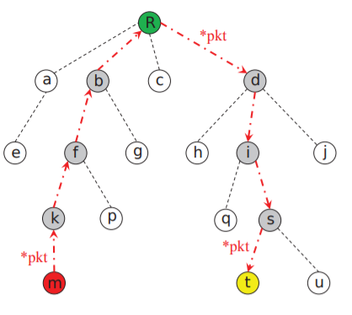
Previous Work
Systems | Limitations
Energy depletion attack Attackers send a lot of packets to a target node to exhaust its battery. C. Pu, “Energy Depletion Attack Against Routing Protocol in the Internet of Things,” in 2019 16th IEEE Annual Consumer Communications & Networking Conference, Jan 2019. | The whole network does not suffer.
Hatchetman attack All attackers send packets with wrong routing information to their neighbors. C. Pu and T. Song, “Hatchetman attack: A denial of service attack against routing in low power and lossy networks,” in 5th IEEE International Conference on Cyber Security and Cloud Computing, Jun 2018. | No coordination among attackers. Does not select the target neighbors optimally.

Slide 6
Capacity-Aware DDoS Attack in LLN (CADAL)
Attackers
  Get reporting paths of neighbors by eavesdropping on their packets.
  Send neighbors’ reporting paths to the master.
  Can attack a limited number of neighbors at the highest rate.
Master
  Formulate partial topology from reporting paths.
  Selects a set of attackers and target neighbors to maximize attack strength.
Link on reporting path
regular link
Actual topology
Master’s view

Slide 7
Problem Formulation
Attack data rate=1
Max data rate=1
Attacker’s capacity=1
Attack Strength:
  Attack data receiving rate at root.
Problem:
  Find the smallest set of target neighbors.
Constraint:
  Attack strength must be the maximum.
  Number of target neighbors of each attacker < attacker’s capacity.
Attack direction
1
1
1
1
1
1
1
1
1
1
1
1
1
1
Attack strength =1 (not maximum)
Attack strength =3 (maximum)

Slide 8
Solution
Step 1: Neighbor Pruning
  Rule 1: Remove attacker neighbors
  Rule 2: Remove neighbors having attacker on reporting path
Step 2: Flow Graph Creation
  Add virtual source node
  Add edges from S to all attacker
  Set link capacity
Step 3: Optimal Target Set Computation
  Max flow problem solving
Rule 1
Rule 2
Rule 2
Master’s view
After pruning

Slide 9
Solution
Attacker’s capacity = 2
Step 1: Neighbor Pruning
  Rule 1: Remove attacker neighbors
  Rule 2: Remove neighbors having attacker on reporting path
Step 2: Flow Graph Creation
  Add virtual source node
  Add edges from S to all attacker
  Set link capacity
Step 3: Optimal Target Set Computation
  Max flow problem solving
After pruning
Flow graph

Slide 10
Solution
Attacker’s capacity = 2
Target neighbor set = {B, C, I}
Attack strength = 3
Step 1: Neighbor Pruning
  Rule 1: Remove attacker neighbors
  Rule 2: Remove neighbor having attacker on reporting path
Step 2: Flow Graph Creation
  Add virtual source node
  Add edges from S to all attacker
  Set link capacity
Step 3: Optimal Target Set Computation
  Max flow problem solving
Flow graph
Max flow
Assignment: E->B, H->C, H->I

Slide 11
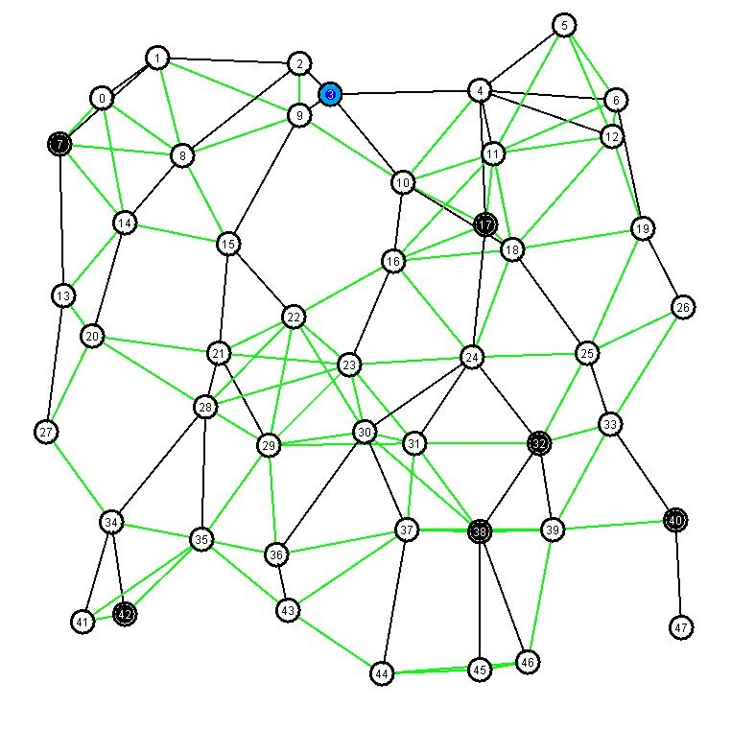
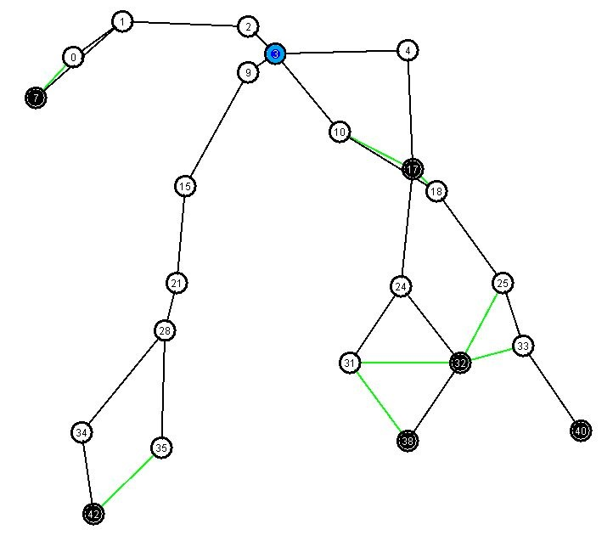
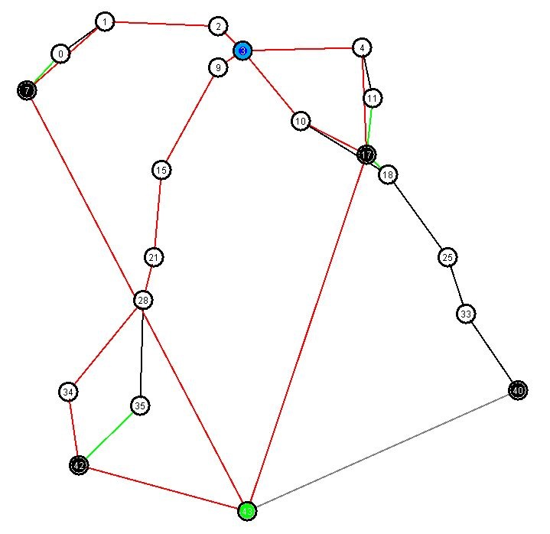
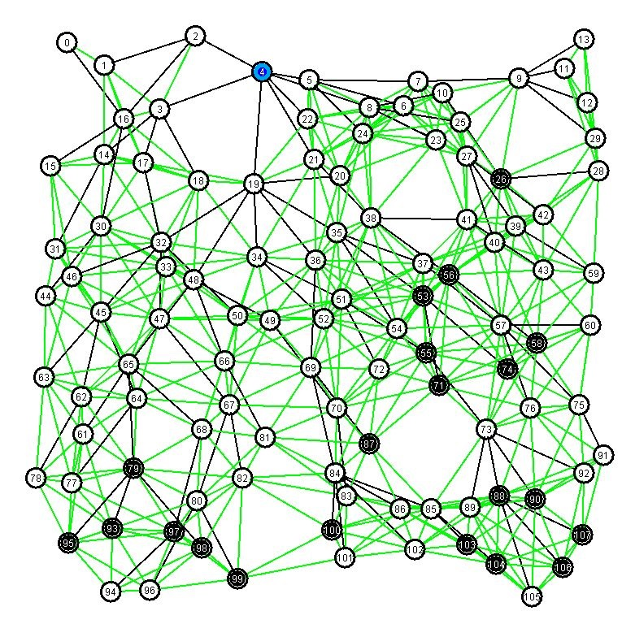
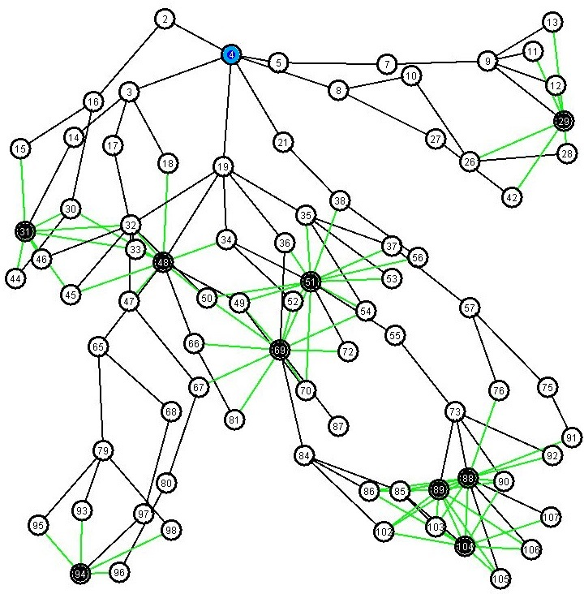
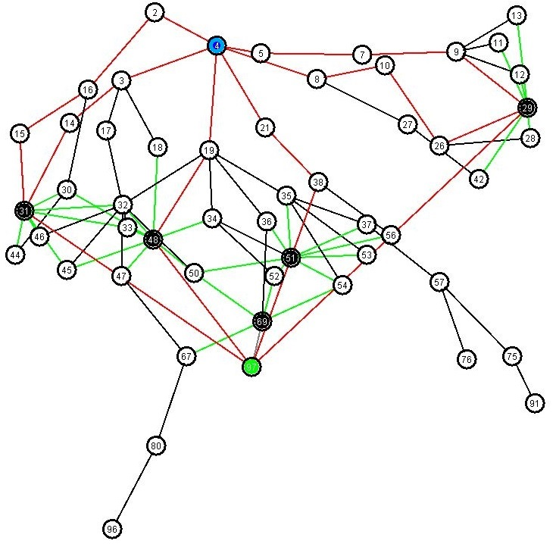
Simulation: Random Tree Generation
Topology I
Nodes:47
Attackers: 6
Edges: 131
Degree: 1-8
Topology II
Nodes:107
Attackers: 9
Edges: 558
Degree: 2-17
Topology I
Actual topology
Master’s view
Flow graph
Unite disk graph
Randomly placed nodes (uniform)
Area: 500x500
Neighborhood radius: 70
Attacker capacity: 2
Attacker ratio: 10%
Topology II

Slide 12
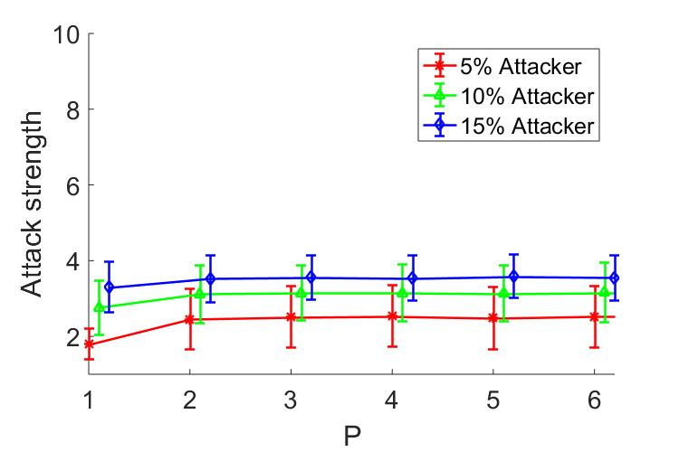
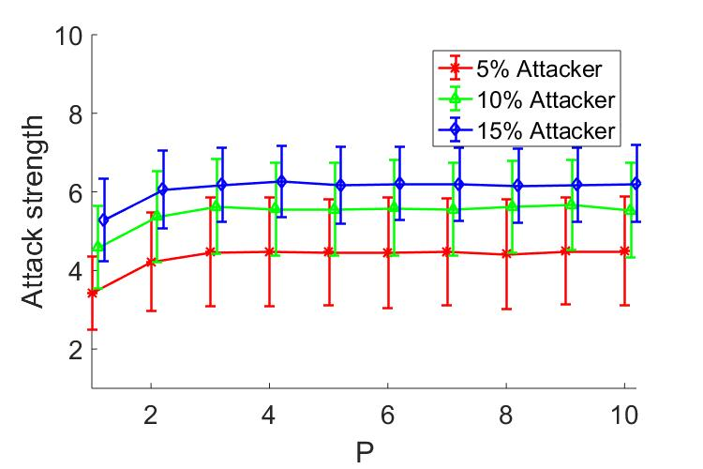
Simulation: Different Attacker Capacities
Topology I
Topology II
Attack strength becomes stable after a certain attacker capacity

Slide 13
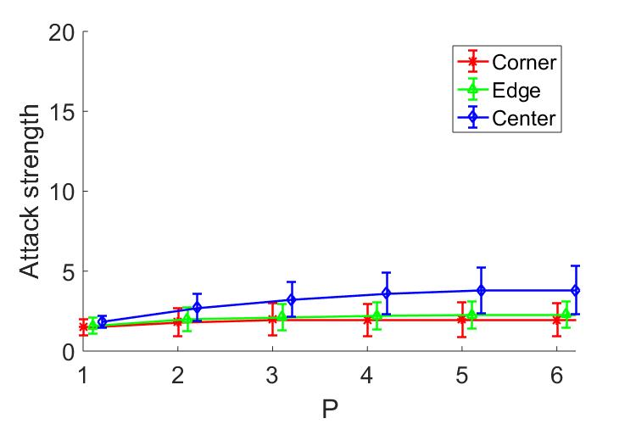
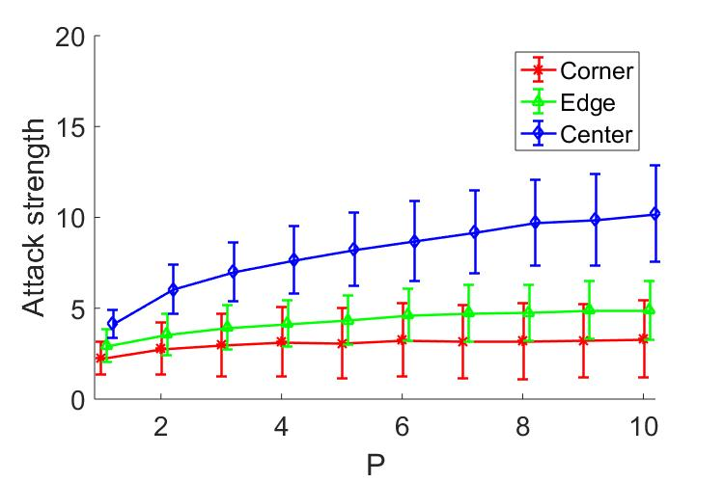
Simulation: Different Root Location
Topology I
Topology II
Root at center is more vulnerable than edge and corner.

Slide 14
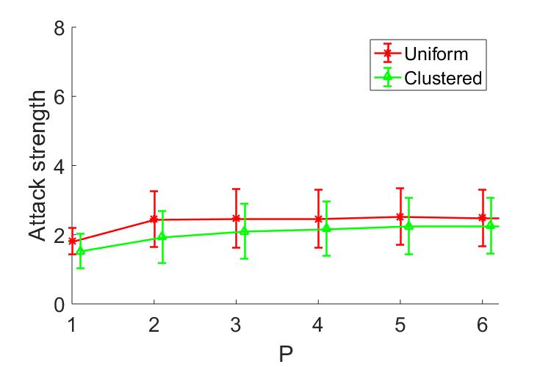
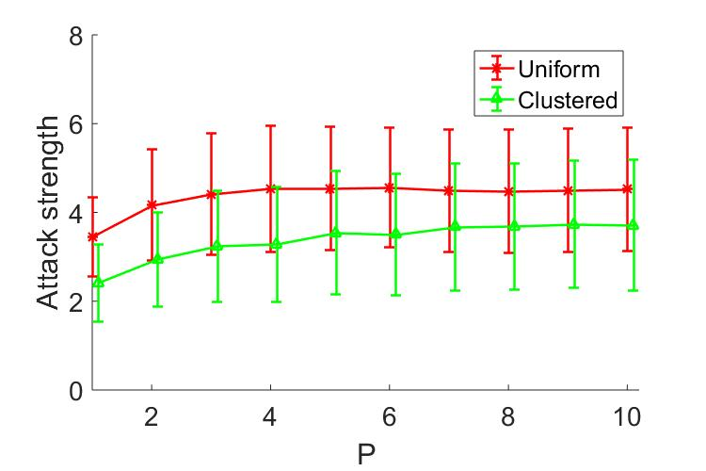
Simulation: Different Attacker Distribution
Topology I
Topology II
Distributed attackers are more powerful than clustered attackers.
Attacker ratio =10%

Slide 15
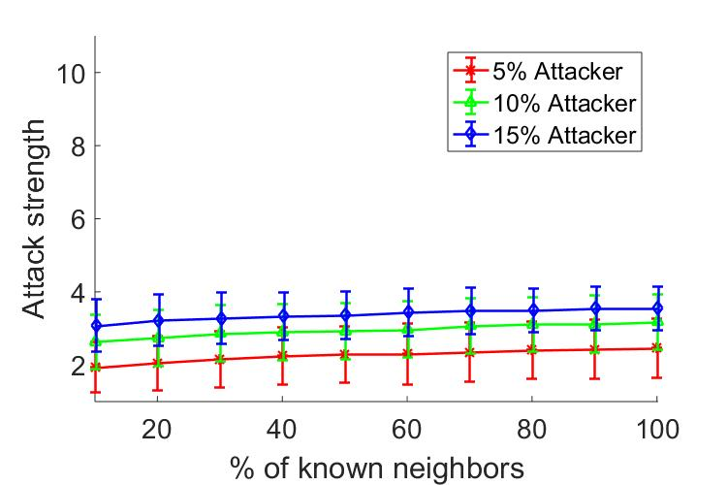
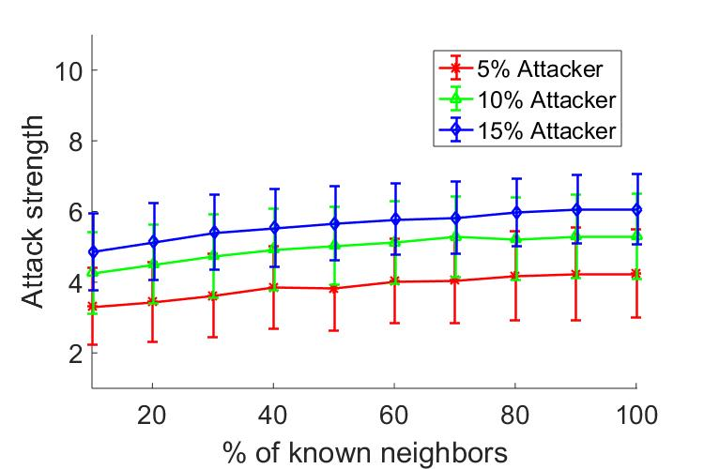
Simulation: Different Neighborhood Knowledge
Topology I
Topology II
Var p
More knowledge about the neighborhood results in more powerful attack
Attacker power (P)= 2

Slide 16
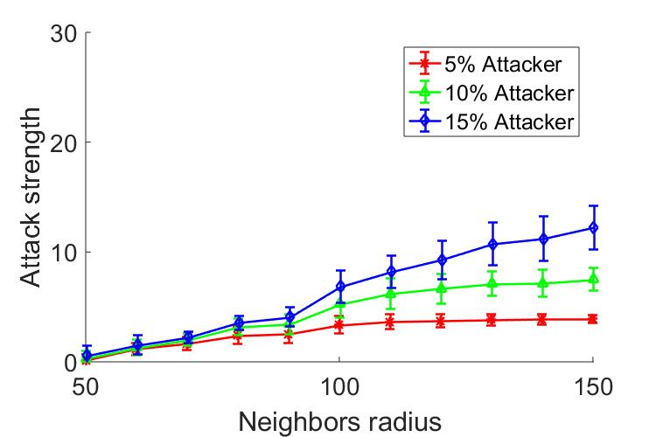
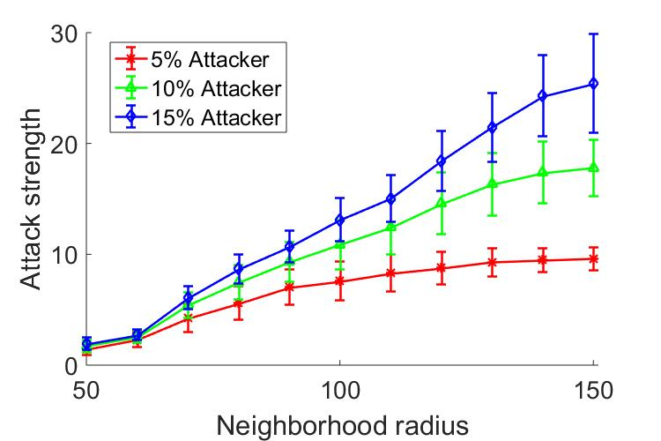
Simulation: Different Neighborhood Radius
Topology I
Topology II
Var p
The greater the neighborhood radius, the more the degree and attack strength
Attacker power (P)= 2

Slide 17
Conclusion
A powerful DDoS attack is possible with
a small number of attackers
having little capacity of attack
in a dense network
when the root is in middle.

Slide 18
Q & A ???

