Slide 1

Filter Assignment Policy Against Distributed Denial-of-Service Attack
Rajorshi Biswas and Jie Wu
Dept. of Computer and Info. Sciences
Temple University

Slide 2
DDoS & Four-phase Protection System
DDoS
  Attacker keeps the victim busy.
  Millions of requests are fired by bots.
  Bots are controlled by a master.
Background
  Filter router
    Does packet marking.
    Apply filter and block traffic according to filter.
  Filter
    Simple packet blocking rule.
    Source-based, destination based.
Filter:
If (source=“129.32.224.10”)
discard
Else
forward
129.32.224.10
Router plugins: a software architecture for next generation routers (Dan Decasper et al. in ACM SIGCOMM '98)

Slide 3
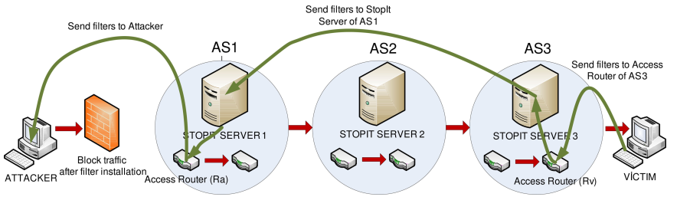
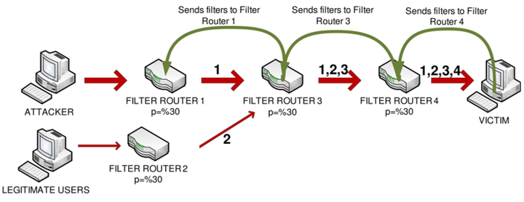
Previous work
Systems | Limitations
StopIt (put filter to StopIt server ) | Needs a server to send filter to appropriate server. Does not consider limited budget on filters.
Probabilistic Filter Scheduling ( packet marking) | Does not consider limited budget on filters. Filter propagation takes some time. Hard to send huge number of filters.
To filter or to authorize: Network-layer DoS defense against multimillion-node botnets (X. Liu et al. at ACM SIGCOMM Comput, 2008)
PFS: Probabilistic filter scheduling against distributed denial-of-service attacks (D. Seo et al. in IEEE 36th Conf. Local Comput. Netw, Oct. 2011)

Slide 4
A Four-phase Protection Process
Phase I: Packet marking by Filter Router.
Phase II: Traffic topology and filter construction.
Phase III: Assign filters to filter router.
Phase IV: Evict unused filter from filter router.
Packet marking (FR)
Topology construction (V)
Filter assignment (V)
Evict filter (FR)

Slide 5
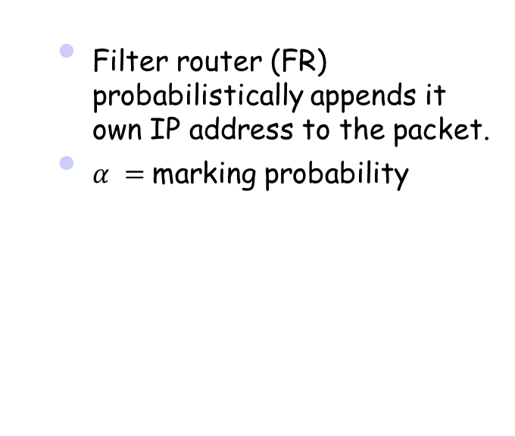

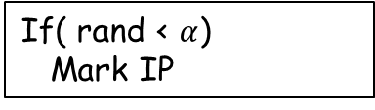
Phase I: Packet Marking by FR
  Filter router (FR) probabilistically appends it own IP address to the packet.
  $α =$marking probability
If( rand < $α$)
Mark IP
S
1
2
3
4
V
2
2 4
Example received packets, $α=0.5$
1 2
1 4
2 4
3
2 3
2 3 4
1
From user S

Slide 6
Phase II: Topology Construction
V
S1
S1 4
V
4
3
S2
S2 5 3
S1
S3
S3 7 3
5
7
S1
S2
S3
S2
S3
Without any marking
After few marking received
V
V
S1 1 4
4
S1 6 4
4
S2 3 4
1
S2 4
3
1
3
S3 2 7
S1
S3 3
6
5
7
5
7
S2
2
S2
2
S1
S3
S3
After few more marking received
After some more marking received

Slide 7
Identifying Attackers’ IP
V
Victim can identify attacker.
  Statistical approaches, packet arrival time, entropy, etc.
Black=only attacker traffic
White= only legitimate traffic
Gray=mixed traffic
4
1
3
6
5
7
S2
2
S1
S3
The number of attackers is very large. Sending filters to all of them takes a lot of time.
The capacity of filters in a FR is limited. So the hosting ISP of FR may charge money.

Slide 8
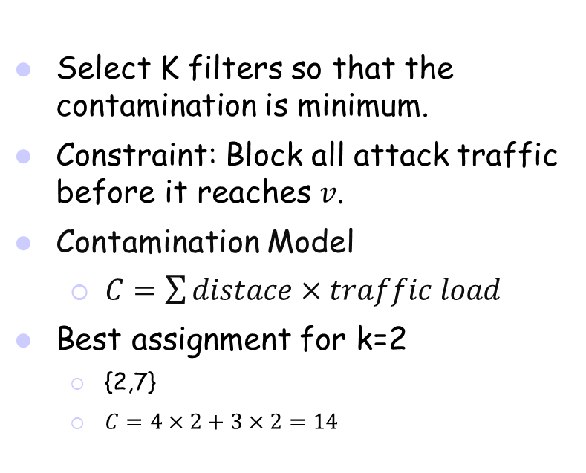
Problem1: Minimizing Contamination
Select K filters so that the contamination is minimum.
Constraint: Block all attack traffic before it reaches 𝑣.
Contamination Model
  $C=\sum{distace×traffic load}$
Best assignment for k=2
  {2,7}
  $C=4×2+3×2=14$
v
7
1
2
5
10
1
1
1
1
2
3
4
4
15
6
3
Problem complexity still unknown.

Slide 9
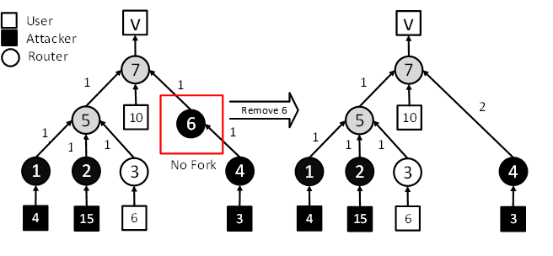
Simplifying the Topology
Remove nodes with no fork.

Slide 10
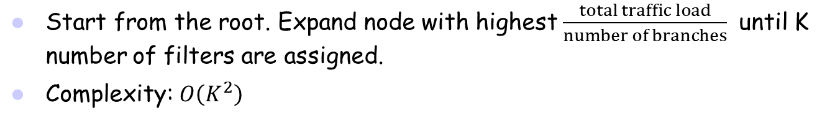
Naive Approximation (Top-down)
Start from the root. Expand node with highest $\frac{total traffic load}{number of branches}$ until K number of filters are assigned.
Complexity: $O\left(K^{2}\right)$
Expand 7
Expand 5
K=3

Slide 11
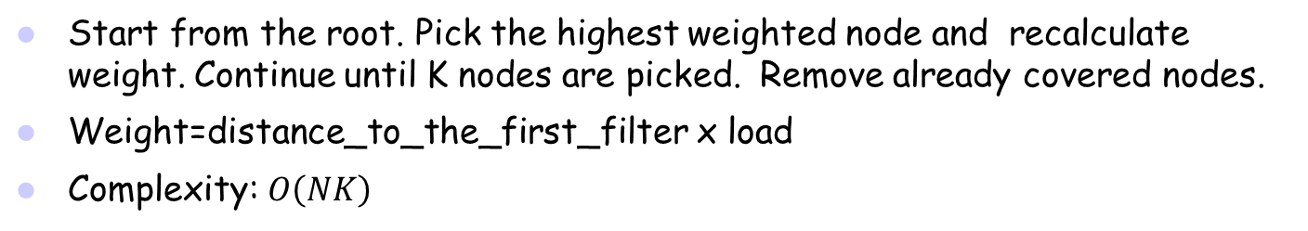
Greedy Approximation 1
Start from the root. Pick the highest weighted node and recalculate weight. Continue until K nodes are picked. Remove already covered nodes.
Weight=distance_to_the_first_filter x load
Complexity: $O\left(NK\right)$
1 | 2 | 4 | 5 | 7
8 | 30 | 6 | 19 | 0
1 | 2 | 4 | 5 | 7
8 | 0 | 6 | 4 | 0
1 | 2 | 4 | 5 | 7
0 | 0 | 6 | 0 | 0
1 | 2 | 4 | 5 | 7
0 | 0 | 0 | 0 | 0
Select root
Select 2
Select 1
Select 4, remove 7

Slide 12
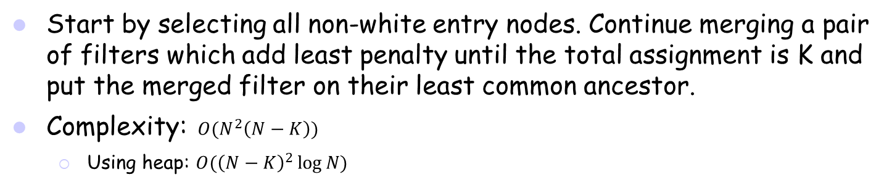
Greedy Approximation 2 (Bottom-up)
Start by selecting all non-white entry nodes. Continue merging a pair of filters which add least penalty until the total assignment is K and put the merged filter on their least common ancestor.
Complexity: $O(N^{2}\left(N−K\right))$
  Using heap: $O({\left(N−K\right)}^{2}\log{N)}$
Penalty (1,2)=4+15
Penalty (2,4)=6+15x2=36
Penalty (1,4)=4x2+3x2=14
Penalty (2,7)=15x2+0=30
K=2
K=1
K=3
Penalty= Amount of contamination increase for a merge.

Slide 13
Greedy Approximation 2 is Not Optimal
Greedy Approximation 2
K=10
Contamination=9.7
Optimal
K=10
Contamination=9.1

Slide 14


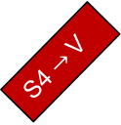
Source-based and Destination-based filters
Source-based
If source=“S1” or “S2”
Discard
Else
Forward
Source-based filter
  Filtered by source address of packet.
  Cannot protect IP spoofing DDoS.
Destination-based filter
  Filtered by destination address of packet.
  Can protect against IP spoofing DDoS.
  Blocks legitimate traffic.
S4 $→$V
S4
S1
S2
S3
S5
Dest-based
If dest=“V”
Discard
Else
Forward
S4 $→$V
S4
V $← S3$
S1
S2
S3
S5

Slide 15
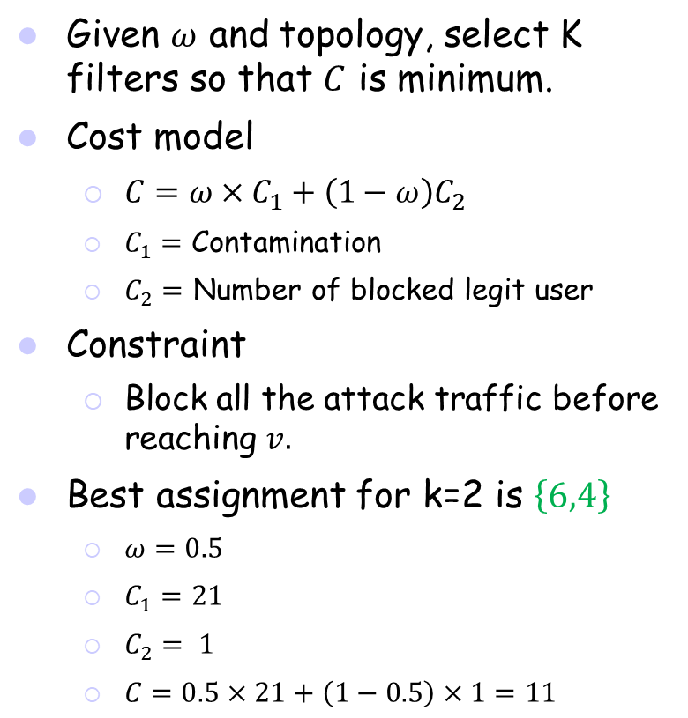
Problem 2: Minimizing Contamination and Blocked Legit Users
Given $ω$ and topology, select K filters so that $C$ is minimum.
Cost model
  $C=ω×C_{1}+\left(1−ω\right)C_{2}$
  $C_{1}=$ Contamination
  $C_{2}=$ Number of blocked legit user
Constraint
  Block all the attack traffic before reaching $v.$
Best assignment for k=2 is $\left\{6,4\right\}$
  $ω=0.5$
  $C_{1}=21$
  $C_{2}= 1$
  $C=0.5×21+\left(1−0.5\right)×1=11$
v
8
6
10
7
6
15
1
2
3
4
7
5
1
15
6
3
15

Slide 16
A dynamic programming solution
Blocks all legitimate users
P₁(N, K)
P₂(N, K)
K
K
1
N
N
K-1
P₂(L, i)
P₂(R, K-i)
OR
i
K-i
L
R
L
R
Minimize contamination in this area
i=0,1,…,K
In subtree rooted by N for K filters:
  P₁(N, K)= Minimum contamination ensuring a filter to N.
  P₂(N, K)= Minimum cost.
  L(N)= Number of legitimate users.
Complexity: O(NK^{(D-1)})

Slide 17

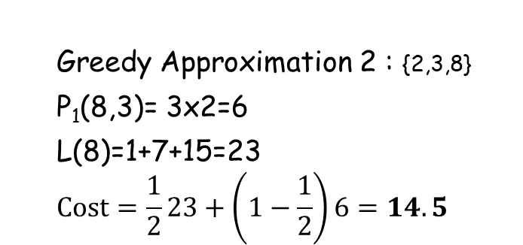
A Dynamic Programming Solution:
An Example
P₁(8, 3)
P₂(8, 3)
K=3
P₂(6, i)
P₂(7, 3-i)
K=2
K=0 1 2 3
K=3 2 1 0
OR
i=0,1,2,3
  Greedy Approximation 2 : {2,3,8}
  P₁(8,3)= 3x2=6
  L(8)=1+7+15=23
  $$Cost=\frac{1}{2}23+\left(1−\frac{1}{2}\right)6=14.5$$
$$0$$

Slide 18



A DP Solution: An Example
P₂(6, 0)
P₂(7, 3)
P₂(6, 1)
P₂(7, 2)
K=0
K=3
K=1
K=2
$∞ + 0=∞$
$11 + 0=11$
P₂(6, 2)
P₂(7, 1)
P₂(6, 3)
P₂(7, 0)
K=2
K=1
K=3
K=0
$$0 + 0=0$$
$$0 + ∞=∞$$

Slide 19
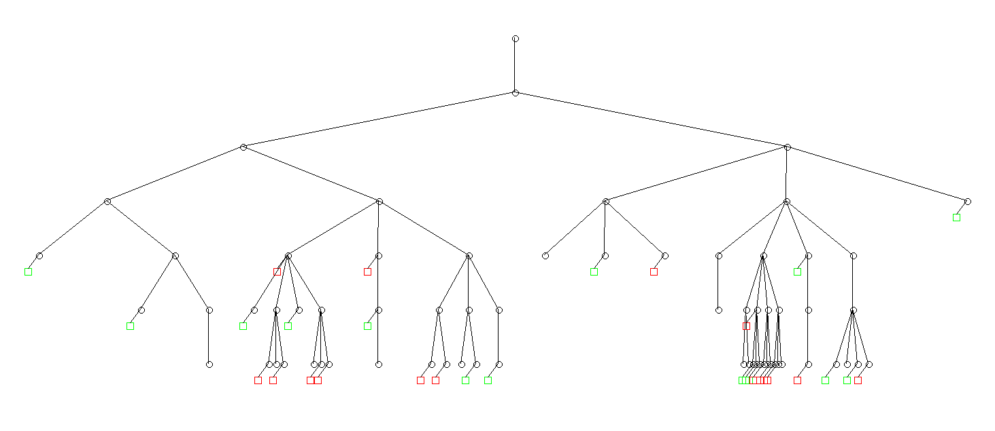
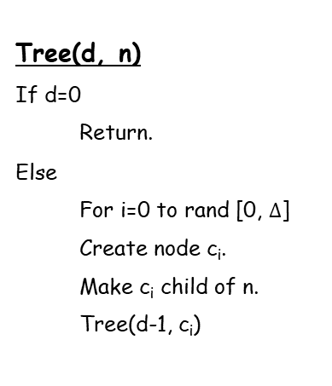
Simulation: Random Tree Generation
v
Tree(d, n)
If d=0
  Return.
Else
  For i=0 to rand [0, $Δ$]
  Create node c_{i}.
  Make c_{i} child of n.
  Tree(d-1, c_{i})
Topology: 1
# of nodes : 66
Attacker ratio: 50%
Maximum degree=4
Depth=5
Data rate= 1 to 4

Slide 20
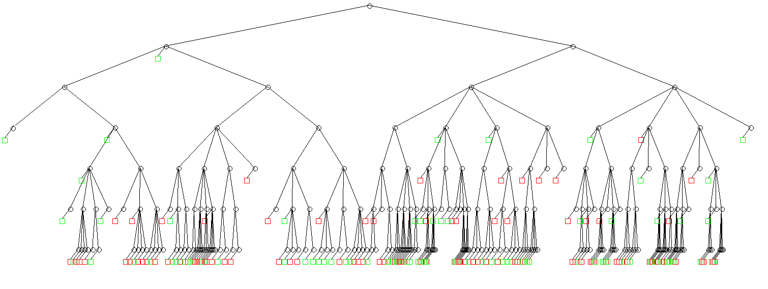
Simulation: Random Tree Generation
v
Topology: 2
# of nodes : 250
Attacker ratio: 60%
Maximum degree=4
Depth=6
Data rate= 1 to 10

Slide 21
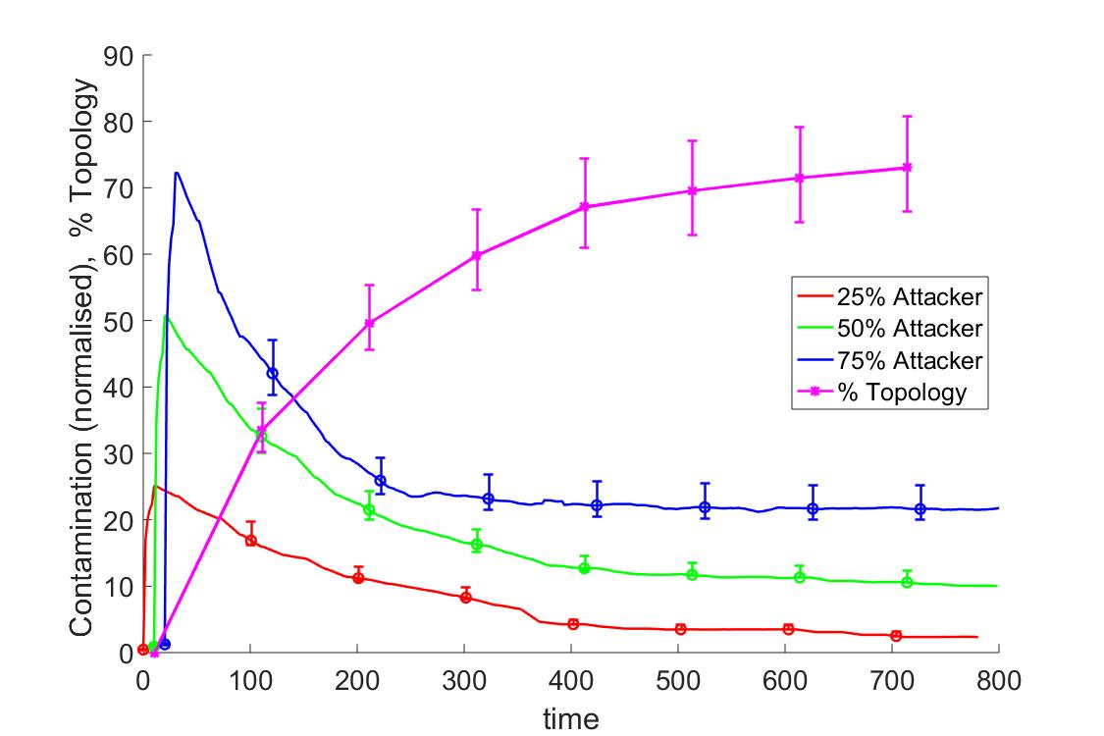
Simulation: Greedy 2 Timeline
Topology 1 used
K=10

Slide 22
Simulation: Problem 1 Approaches
Subset of 200 Topologies are shown
Greedy 1: 43% more
Greedy 2: 26% more
Naive: 167% more
Contamination (Normalized)
Samples=200
Nodes=25-35
Data rate=1-3
Max depth=4
Max degree=3
Attacker ratio= 50%

Slide 23
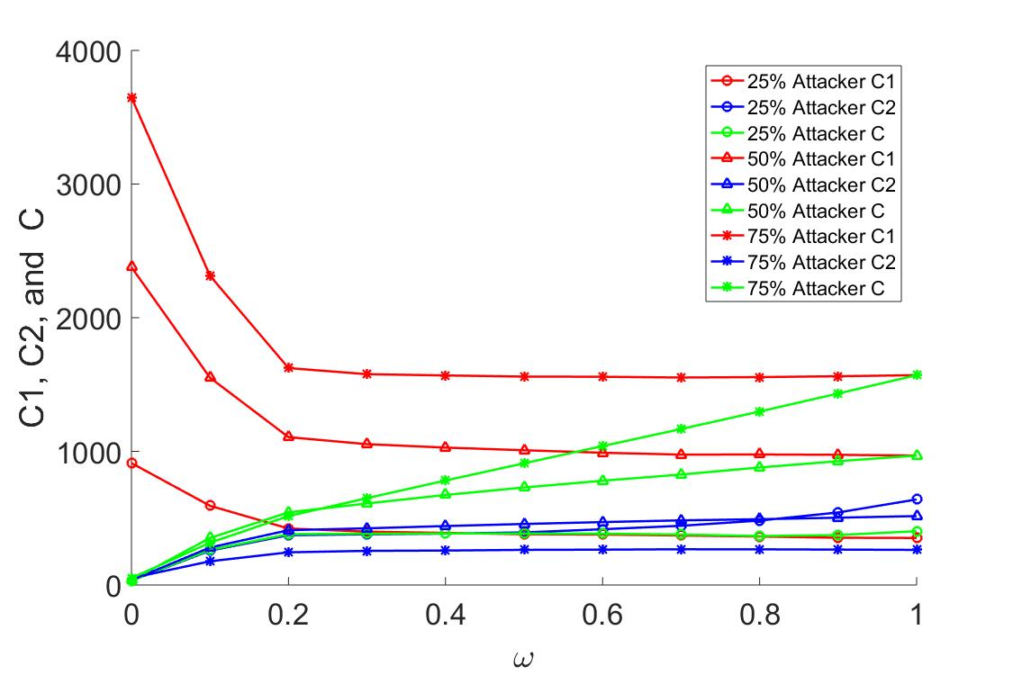

Problem 2: Effect of $ω$
Topology 2 was used
K=10
C1, C2 and C when C is minimum

Slide 24
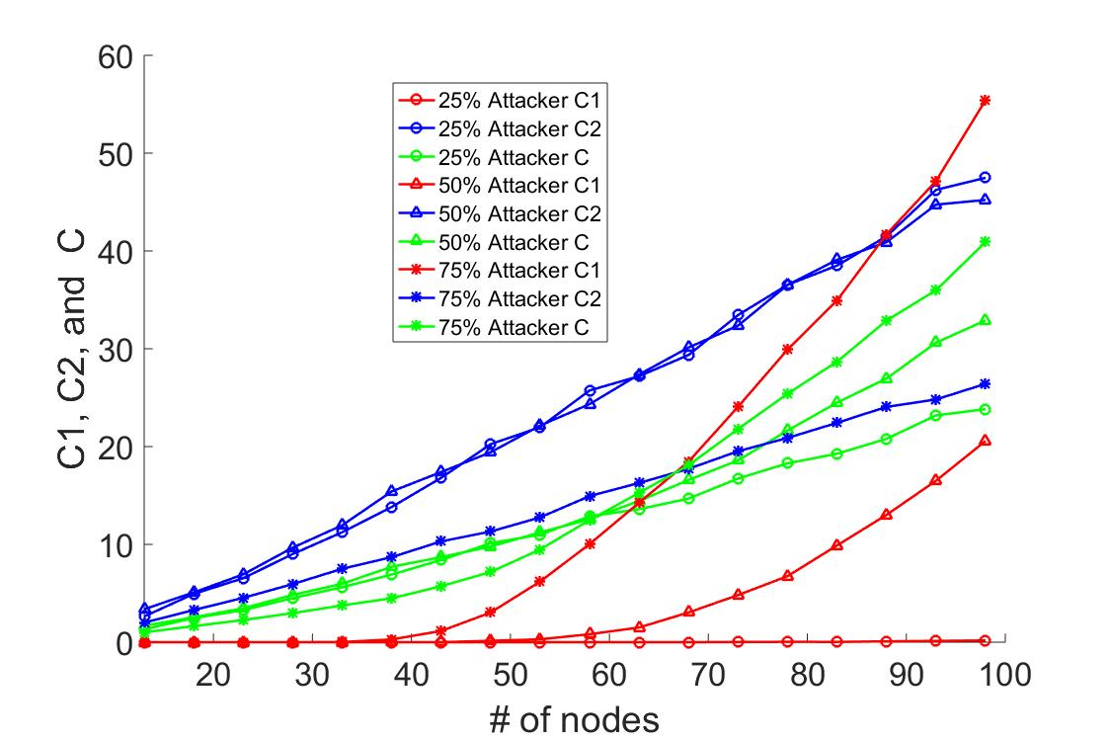
Problem 2: Effect of # of Nodes
Randomly generated topologies were used.
Each point is average of 100 samples
K=20
C1, C2 and C when C is minimum
C1, C2 and C when C is minimum

Slide 25
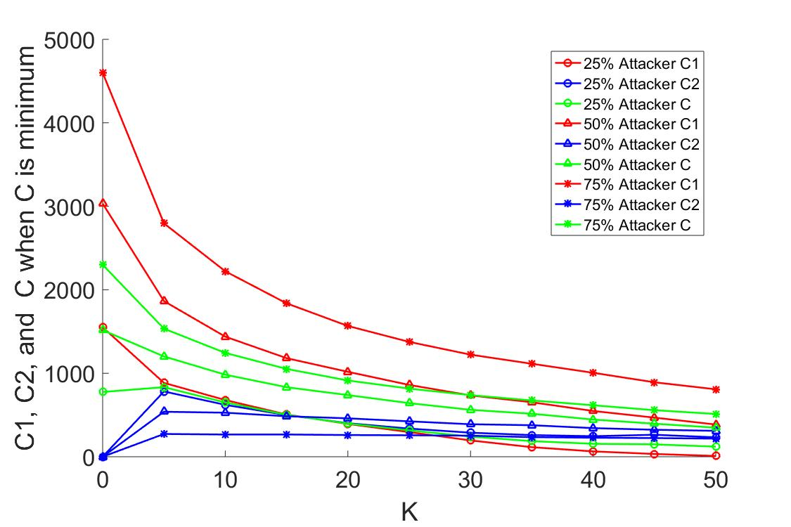
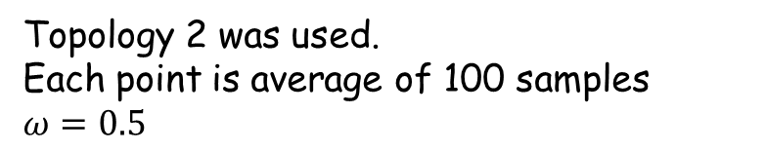
Problem 2: Effect of K
Topology 2 was used.
Each point is average of 100 samples
$ω=0.5$

Slide 26
Summery
The Greedy Approximation 2 is the best solution among Greedy Approximation 1 and Naïve Approximation.
Optimality of DP solution depends on optimality of problem 1’s solution.

Slide 27
Q&A

