Slide 1

Mitigation of the Spectrum Sensing Data Falsifying Attack in Cognitive Radio Networks
Rajorshi Biswas, Jie Wu, and Xiaojiang Du
Dept. of Computer and Information Sciences
Temple University

Slide 2

Road Map
  Cooperative spectrum sensing
  Previous work
  Majority voting and existing models
  Weighted majority voting with confidence
  Simulation results
  Extension: two-level majority voting
  Conclusion

Slide 3
1. Cooperative Spectrum Sensing
  Primary user (PU)
    Licensed user, high priority
  Secondary user (SU)
    Send sensing information to aggregator
  Malicious secondary user (MSU)
    Send opposite sensing information to aggregator
  Aggregator
    Does majority voting
    Results are sent back to SUs and MSUs
1
1
1
Aggregator
1
1
SU
0
PU=1
0
1
1
0
SU’s wrong sensing and MSU’s result
can change aggregator’s decision
Solution: reduce weight of MSUs through reputation
PU=1
1
0
MSU
Notes:
PU=1: primary user present
PU=0: primary user absent
First figure:
SU can make mistake.
Second figure:
MSU sends opposite sensing information. MSU can also make mistake. MSUs mistake provides current result to aggregator.
SU/MSU ranges
S. Maric, S. Reisenfeld and L. Goratti, "A simple and highly effective SSDF attacks mitigation method," 2016 10th International Conference on Signal Processing and Communication Systems (ICSPCS), Gold Coast, QLD, 2016
Number of SU: 35
Number of MSU: 15
(From another paper)
MSU+SU=20
% of MSU varied 0%-95%

Slide 4
2. Previous Work
MSU detection systems | Limitations
Linear reputation-based system. SUs send raw sensing information to Aggregator. If a SU agrees with aggregator, reputation increases by “1” or decreases by “1”. | Computation overhead is high for processing raw sensing information. Linear reputation update mechanisms are not efficient enough.
Active transmission-based system. | PU emulated signals can be detected. MSU will respond correctly to emulated signal.
R. Chen, J. -. Park and K. Bian, "Robust Distributed Spectrum Sensing in Cognitive Radio Networks," IEEE INFOCOM 2008.
PU emulated signal
Sensing result
T. Bansal, B. Chen, and P. Sinha, “Fastprobe: Malicious user detection in cognitive radio networks through active transmissions,” in IEEE INFOCOM 2014.
Notes:
Why computation overhead is high?
Aggregator need to process raw sensing information.

Slide 5
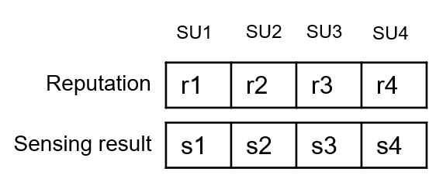
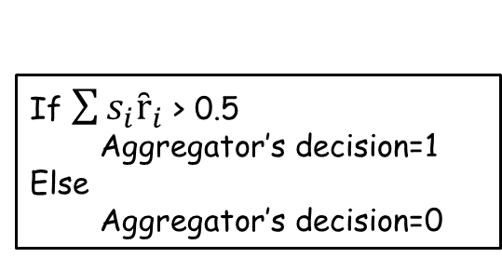

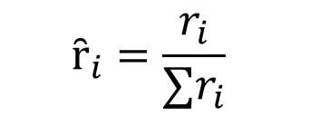
3. Majority Voting and Existing Models
$$ȓ_{i}=\frac{r_{i}}{∑r_{i}}$$
$ȓ_{i}=$ normalized reputation
If $\sum{s_{i}ȓ_{i}}$ > 0.5
Aggregator’s decision=1
Else
Aggregator’s decision=0
Initial reputation=1
Aggregator makes decision
Update reputation of SUs and MSUs using Reputation Update Function (RUF)
Notes:
Range of $η$ =[0,1]
Lecture note 16. paper will be provided.
Range of $μ$ =[0,1]
This factor can be varied according to system requirements. This is a simplified method of recording reputation, and more complicated representations, such as a Beta distribution may yield better performance. From paper DRBTS: Distributed Reputation-based Beacon Trust System (jie wu, avinash)

Slide 6
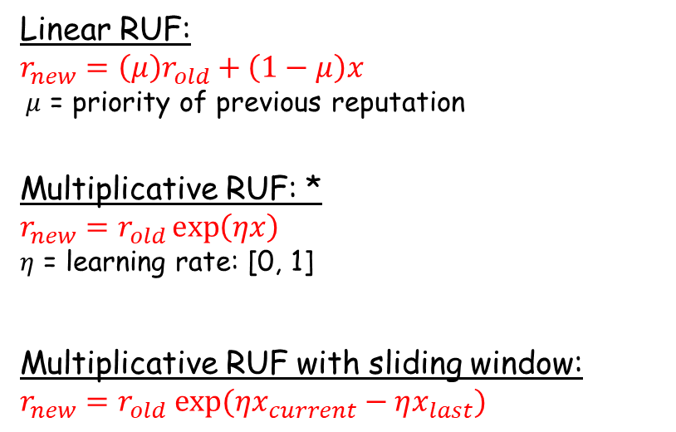


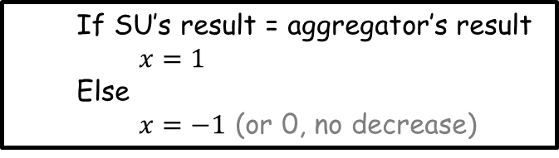
Majority Voting and Existing Models
Linear RUF:
$${r_{new}=\left(μ\right)r}_{old}+\left(1−μ\right)x$$
$μ$ = priority of previous reputation
Multiplicative RUF: *
$${r_{new}=r}_{old}\exp\left(ηx\right)$$
$η$ = learning rate: [0, 1]
Multiplicative RUF with sliding window:
$${r_{new}=r}_{old} exp⁡(ηx_{current}−ηx_{last})$$
  If SU’s result = aggregator’s result
  $x=1$
  Else
  $x=−1$ (or 0, no decrease)
-1 | 1 | 1 | 1 | -1 | 1 | 1
$x_{last}$
Sliding window
$$x_{current}$$
*Arora, Sanjeev, Elad Hazan, and Satyen Kale. "The multiplicative weights update method: a meta-algorithm and applications." Theory of Computing 8.1 (2012)
Notes:
Range of $η$ =[0,1]
Lecture note 16. paper will be provided.
Range of $μ$ =[0,1]
This factor can be varied according to system requirements. This is a simplified method of recording reputation, and more complicated representations, such as a Beta distribution may yield better performance. From paper DRBTS: Distributed Reputation-based Beacon Trust System (jie wu, avinash)

Slide 7
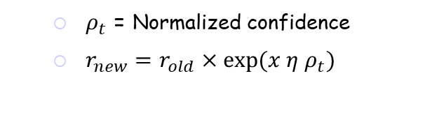
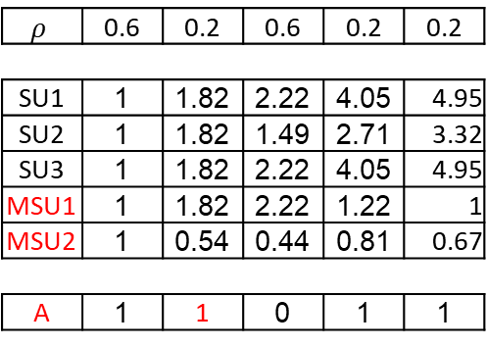


4. Weighted Majority Voting with Confidence
$$η=0.01$$
Adaptive Multiplicative RUF
SU1 | 1 | 2.71 | 7.38 | 20.08 | 54.59
SU2 | 1 | 2.71 | 1 | 2.71 | 7.38
SU3 | 1 | 2.71 | 7.38 | 20.08 | 54.55
MSU1 | 1 | 2.71 | 7.38 | 2.71 | 1
MSU2 | 1 | 0.36 | 0.13 | 0.36 | 0.13
A | 1 | 1 | 0 | 1 | 0
  $ρ_{t}$ = Normalized confidence
  $r_{new}=r_{old}×\exp{(x η ρ_{t})}$
High variance
reputation
Minority: 30
confidence
Majority: 70
$$ρ_{t}=\frac{|70−30|}{70+30}=0.4$$
Without confidence
Ground truth
Time | 0 | 100 | 200 | 300 | 400
PU | 1 | 0 | 0 | 1 | 1
SU1 | 1 | 1 | 0 | 1 | 1
SU2 | 1 | 0 | 0 | 1 | 1
SU3 | 1 | 1 | 0 | 1 | 0
MSU1 | 1 | 1 | 1 | 0 | 0
MSU2 | 0 | 0 | 0 | 0 | 0
A | 1 | 1 | 0 | 1 | 0
$$ρ$$ | 0.6 | 0.2 | 0.6 | 0.2 | 0.2
SU1 | 1 | 1.82 | 2.22 | 4.05 | 4.95
SU2 | 1 | 1.82 | 1.49 | 2.71 | 3.32
SU3 | 1 | 1.82 | 2.22 | 4.05 | 4.95
MSU1 | 1 | 1.82 | 2.22 | 1.22 | 1
MSU2 | 1 | 0.54 | 0.44 | 0.81 | 0.67
A | 1 | 1 | 0 | 1 | 1
Low variance
Sensing
result
reputation
Majority voting
False positive
False negative
With confidence

Slide 8
5. Simulation
  Settings and datasets
  Number of SUs: 10-50
  SU error rate: 0-0.3 (randomly selected)
  Number of MSUs: 7-50
  MSU error rate: 0.7-1 (randomly selected)
  Initial reputation: 1
  Sensing records of 100,000 timeslots.
Dataset type 1
SU
MSU
time
Dataset type 2
SU
MSU
MSU
time
MSUs build reputation
Attack

Slide 9
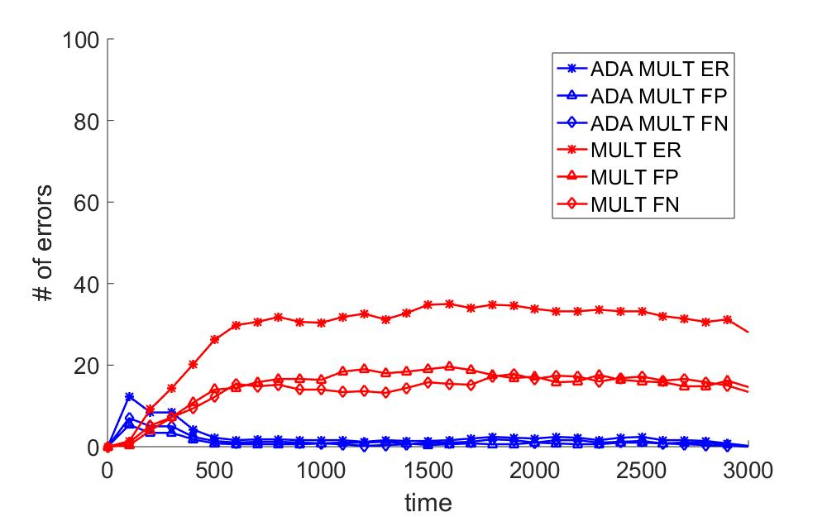
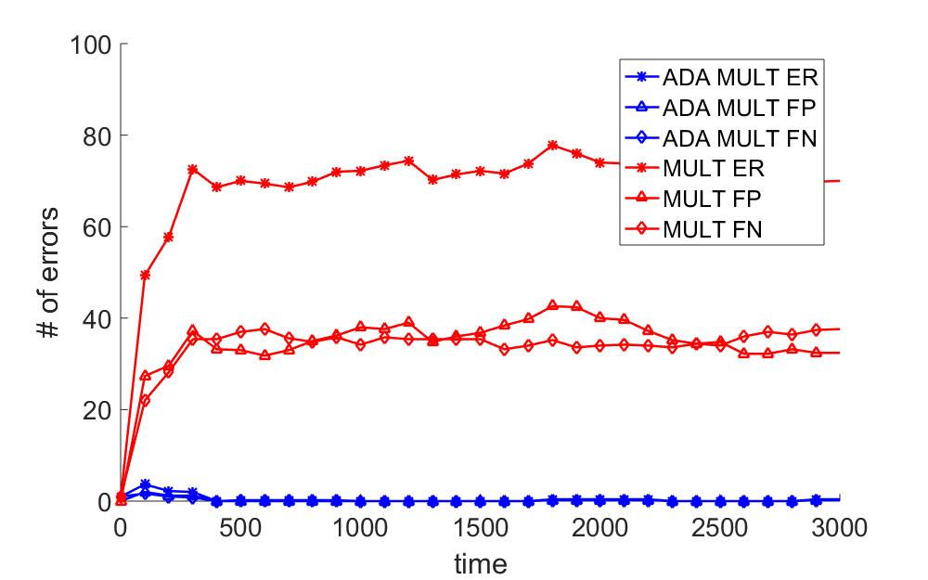
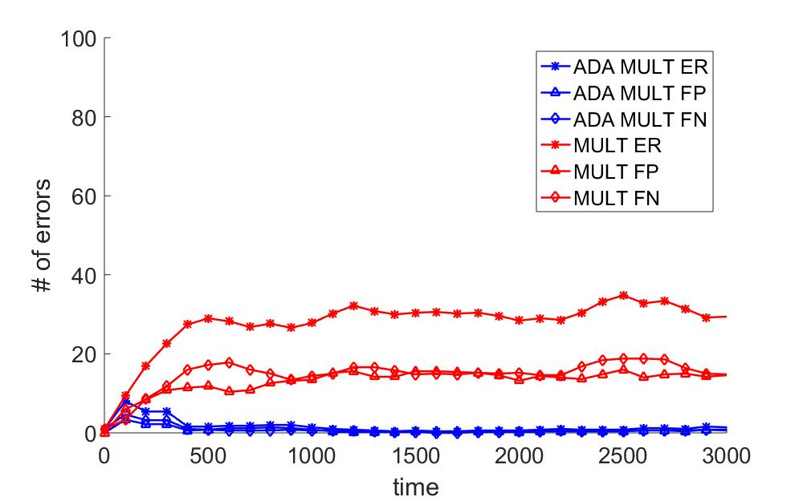
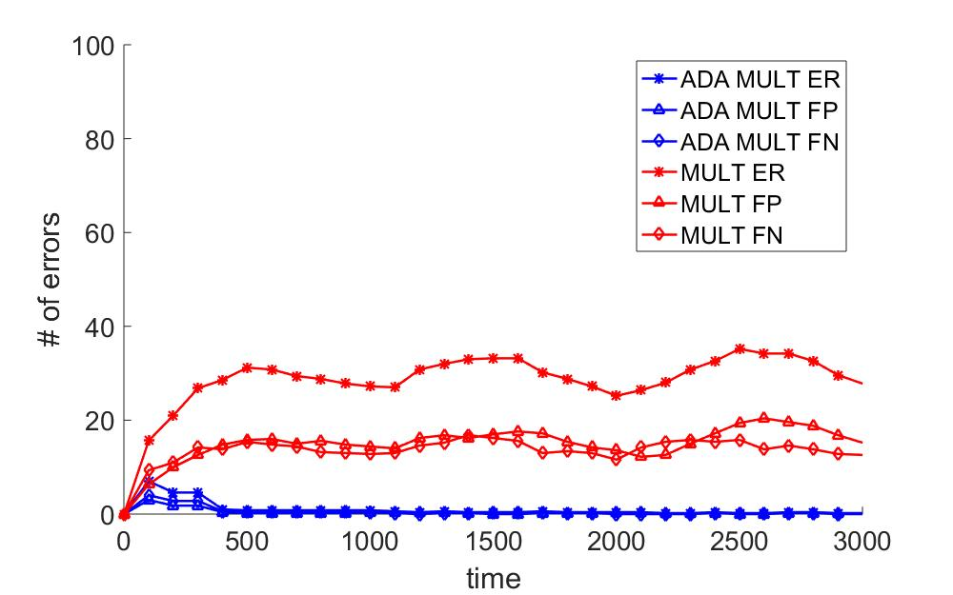
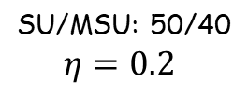
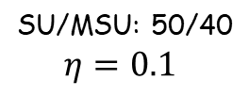
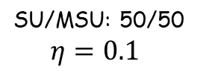
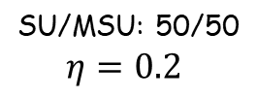
Multiplicative vs. Adaptive Multiplicative RUF
SU/MSU: 50/50
$$η=0.1$$
SU/MSU: 50/50
$$η=0.2$$
SU/MSU: 50/40
$$η=0.1$$
SU/MSU: 50/40
$$η=0.2$$
Dataset type 1 Used for simulation.
False positive (FP), False negative (FN), Error (ER), Adaptive multiplicative (ADA MULT), Multiplicative (MULT)
Notes:
Higher value of $η$ : quick convergence.
Higher number of MSU: higher error rate.

Slide 10
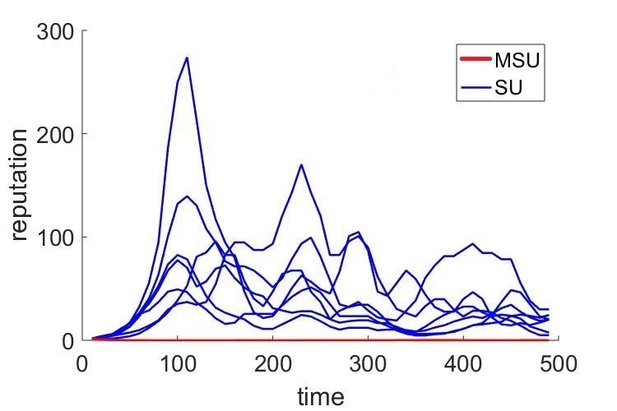
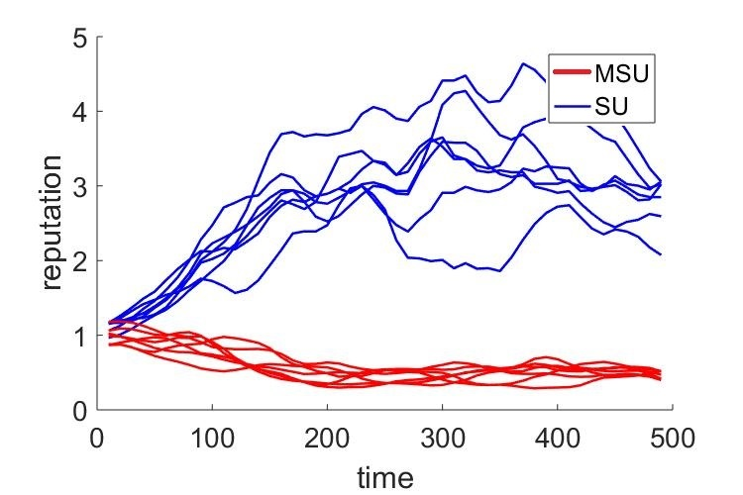
Multiplicative vs. Adaptive Multiplicative RUF
Multiplicative
Adaptive multiplicative
Dataset type 2 with $η=0.01$
High variation of reputation in multiplicative RUF leads to more errors.
Notes:
Multiplicative & adaptive multiplicative is in different scale.
Multiplicative: High variance in SUs’ reputation leads to higher number of error. Mistake from highly reputed SU leads aggregator to make mistake.
Adaptive-multiplicative: SUs reputation are similar.

Slide 11
6. Extension: Two-Level Majority Voting
  13 MSUs (clustered)
  13 SUs
  2 wrong aggregators
  4 correct aggregators.
  MSUs may win in one-level voting
  MSU cannot win in two-level voting
Connected dominating set based distributed aggregator selection process

Slide 12
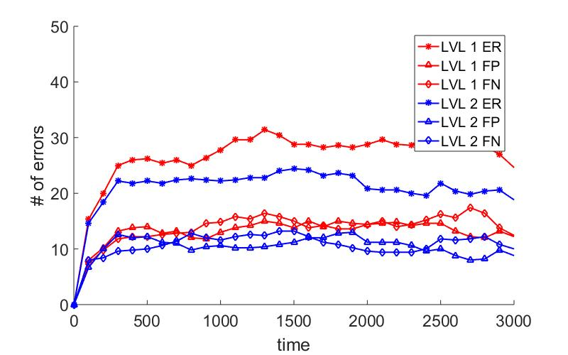
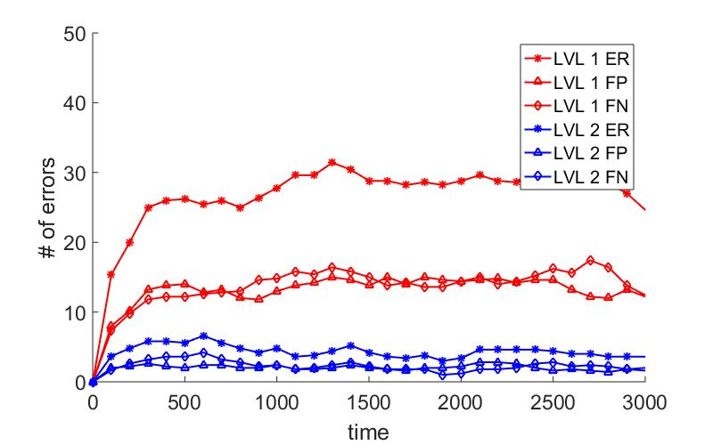
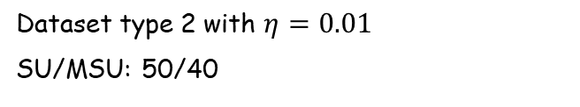
Two-Level vs. One-Level Voting
MSUs are sparse (uniform).
MSUs are clustered.
False positive (FP), False negative (FN), Error (ER), Level 1 (LVL 1), and Level 2 (LVL 2)
Dataset type 2 with $η=0.01$
SU/MSU: 50/40
80% MSU: clustered
20% MSU and all SU: uniformly distributed
Two-level voting works better when MSUs are clustered

Slide 13
7. Summary
  Adaptive multiplicative RUF using confidence
  Adaptive multiplicative RUF works better than other RUFs
  Two-level voting produces less errors than one-level voting
1
1
1
Aggregator
1
1
SU
0
PU=1

