Slide 1

Co-existence of LTE-U and Wi-Fi with Direct Communication
Rajorshi Biswas and Jie Wu
Dept. of Computer and Info. Sciences
Temple University

Slide 2

Road Map
  Wi-Fi & LTE coexistence in 5ghz band.
  Two versions of LTE for future (5G).
  Previous work.
  Direct-communication between LTE eNB and Wi-Fi AP.
  Architecture of proposed model.
  Simulation results.
  Summary.
  Q&A

Slide 3
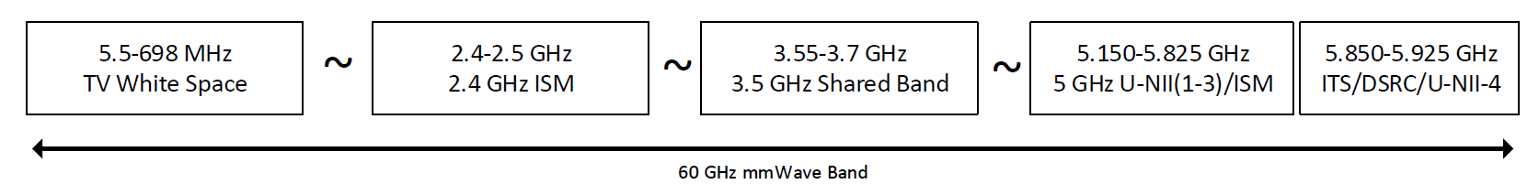
Wi-Fi & LTE Coexistence in 5GHz Band
  Wi-Fi is already operating in 5GHz U-NII bands
    802.11 ac, 802.11 n.
    Unlicensed National Information Infrastructure (U-NII)
  Long Term Evolution (LTE) got permission to 5GHz bands.
Wi-Fi
LTE 5GHz
LTE
Wi-Fi
LTE
LTE
congested
Sensing
No sensing
Sensing
Transmission
Transmission
Occupies whole spectrum all the time
Wi-Fi
LTE
Coexistence: Wi-Fi does not get fair share.
Notes:
LTE regular bands
https://en.wikipedia.org/wiki/LTE_frequency_bands

Slide 4
Two Versions of LTE for Future (5G)
  LTE-LAA (sensing)
    Licensed Assisted Access (Wi-Fi like model).
    Primary: 1800MHz, 1900MHz
    Secondary: 5Ghz U-NII
  LTE-U (no sensing)
    Duty cycle-based.
    Throughput is better than LTE-LAA.
Gives chance to Wi-Fi
Sense
LTE Transmission
LTE on
LTE off
LTE on
LTE off
Needs sensing mechanism at LTE eNB
How to determine duty cycle / fair share ? Ans: CSAT
Longer period
Carrier sensing adaptive transmission (CSAT)*
Sense channel
Estimate channel usage
Decide duty cycle
….
CSAT
LTE on
LTE off
LTE on
LTE off
Limitations:
  Still sensing module is needed.
Our solution:
  Wi-Fi AP sends usage information to LTE eNB (tower).
  Direct-communication between LTE eNB and Wi-Fi AP.
*Qualcomm Research, LTE in Unlicensed Spectrum: Harmonious Coexistence with Wi-Fi. June 2014.
Notes:
LAA
LAA (Licensed Assisted Access) is a standardized version of LTE-U as governed by 3GPP. In certain markets such as the United States, South Korea, and India, a protocol called Listen-Before-Talk (LBT) that was designed to ensure fair coexistence is not enforced as a regulatory requirement.
Listen-before-talk (LBT) is enforced in the regions such as European Union and Japan to harmonize coexistence. In this region LAA can operate but LTE-U cannot.
Given the non-exclusivity of unlicensed bands, one can expect several coexistence issues especially given the popularity of WiFi. While this doesn't mean that LTE-U neglects coexistence issues (they use dynamic channel selection and adaptive duty cycle/CSAT to mitigate collisions), LAA requires LBT to comply with global coexistence standards that apply equally to WiFi.
LBT requires LTE base stations to “listen” (determine channel availability via energy detection) before “talking” or transmitting data. Various LBT approaches exist, but the one recommended by 3GPP is called LBT-Load Based Equipment Category 4. This adds a similar random access protocol that WiFi devices currently use to ensure not only LTE/WiFi coexistence but a standardized way to ensure LTE/LTE coexistence.
However, one disadvantage to this method is that LTE base stations must send a reservation signal to prevent WiFi signals from initiating transmission until the next frame boundary event. LTE devices cannot start transmission unless this requirement is satisfied even if the channel is free. This control overhead can degrade overall network throughput for all technologies.
Carrier-Sensing Adaptive Transmission (CSAT) (from QUALCOMM paper)
Carrier-Sensing Adaptive Transmission (CSAT) In hyper-dense deployment of WiFi and LTE-U small cells, there is a possibility that no clean channel can be found. In such cases, LTE-U can share the channel with neighboring Wi-Fi or another LTE-U system by using CSAT algorithm. Typical Co-channel coexistence techniques in unlicensed bands such as LBT regulations and CSMA (carrier sense multiple access) used by WiFi are based on the concept of contention based access. In these techniques, transmitters are expected to sense the medium and make sure is clean before transmission. The goal of these algorithms then is to provide coexistence across different technologies in a TDM fashion. LTE Advanced in unlicensed spectrum uses a third mechanism (CSAT) that is in-line with the same concept of TDM coexistence based on medium sensing. In CSAT, the small cell senses the medium for longer (than LBT and CSMA) duration (around 10s of msec to 200msec) and according to the observed medium activities, the algorithm gates off LTE transmission proportionally. In particular, CSAT defines a time cycle where the small cell transmits in a fraction of the cycle and gates off in the remaining duration. The duty cycle of transmission vs gating off is dictated by the sensed medium activity of other technologies. CSAT in spirit is similar to CSMA except that it has longer latency, an impact that is mitigated by avoiding channels where WiFi APs use for discovery signals and QoS traffic (i.e. primary channels).” CSAT ensures fair and efficient channel sharing, with the impact of a LTE-U node to its neighboring ©2014 Qualcomm Technologies, Inc. 8 Wi-Fi APs no worse than a neighboring WiFi AP. The LTE-U, which is on the secondary cell, is periodically activated and de-activated using LTE MAC Control Elements. The procedures and timeline are carefully chosen to ensure compatibility with Rel. 10/11 UE behavior. During the LTE-U off period, the channel is clean to neighboring Wi-Fi which can resume normal Wi-Fi transmissions. The small cell will measure Wi-Fi medium utilization during the LTE-U off period, and adaptively adjust On/Off duty cycle accordingly. The TDM cycle can be set to a few hundreds of msec, which can effectively accommodate the activation/de-activation procedures while controlling the data transmission delay.

Slide 5
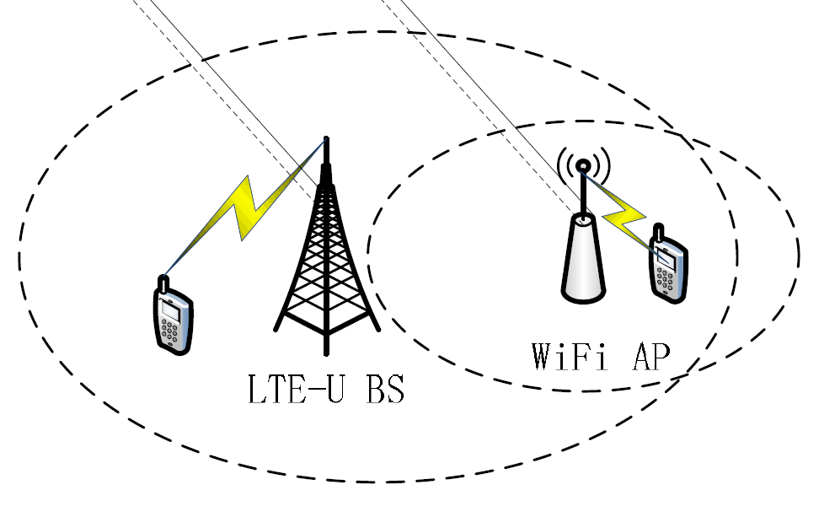
Previous work
Systems | Limitations
Adaptive Almost Blank Subframe (AABS) | Long delay of communication has bad effect on throughput. High overhead of sensing module (LTE keeps sensing).
Reinforcement learning-based resource allocation to LTE-U and WiFi | Computation overhead is high. Non consecutive blank space might reduce Wi-Fi throughput.
C-RAN
LTE-eNB & Wi-Fi AP sends their usage information to the C-RAN.
C-RAN decides LTE channel access mechanism.
An adaptive channel access mechanism for LTE-U and WiFi coexistence in an unlicensed spectrum (Jie Xiao, Jun Zheng in ICC 2016)
Mobile Management Unit (MMU) uses reinforce learning to determine location of blank space in LTE frame. Blank spaces are aperiodic.
Wi-Fi
Wi-Fi
Wi-Fi
Dynamic resource allocation using reinforcement learning for LTE-U and WiFi in the unlicensed spectrum (Ying-Ying Liu, Sang-Jo Yoo in ICUFN 2017)
Notes:
Cloud radio access network (C-RAN), why delay is longer.
C-RAN needs to be hosted in some other location, in cloud. Communication delay with cloud server ranges between 100ms-350ms (depending on cloud location and ISP).
Non consecutive blank space might reduce Wi-Fi throughput.
A long space is better than multiple short spaces. Large Wi-Fi packets are likely to collide with LTE when space is short.

Slide 6
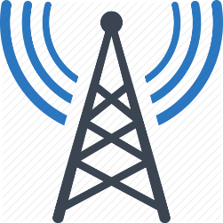

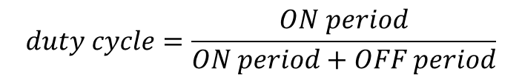
Direct-communication between LTE eNB and Wi-Fi AP
Usage information
$$duty cycle=\frac{ON period}{ON period+OFF period}$$
LTE eNB
Wi-Fi AP
  If Wi-Fi Throughput > LTE Throughput
    More ON period
  Else
    Less ON period
  Assumption: LTE & Wi-Fi have unlimited data to transmit.
LTE on
LTE off
LTE on
LTE off
More ON period
LTE on
LTE off
LTE on
LTE off
More OFF period

Slide 7
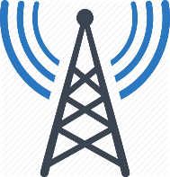


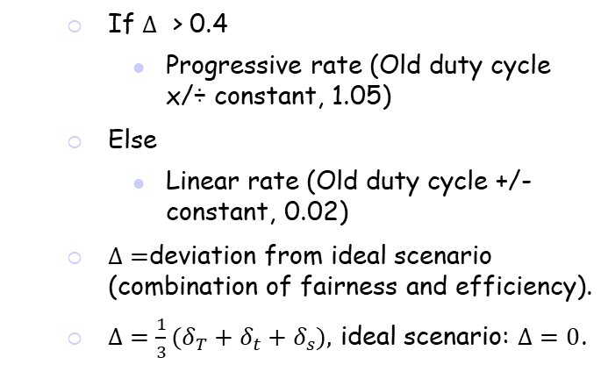


Direct-communication between LTE eNB and Wi-Fi AP
Usage information
Ideal
LTE
Wi-Fi
Wi-Fi AP
fairness
$$δ_{t}$$
LTE eNB
Current
LTE
Wi-Fi
% time
  If $Δ$ > 0.4
    Progressive rate (Old duty cycle x/÷ constant, 1.05)
  Else
    Linear rate (Old duty cycle +/- constant, 0.02)
  $Δ=$deviation from ideal scenario (combination of fairness and efficiency).
  $Δ={\frac{1}{3}(δ}_{T}+δ_{t}+δ_{s}),$ ideal scenario: $Δ=0$.
Ideal
LTE
Wi-Fi
fairness
$$δ_{s}$$
Current
LTE
Wi-Fi
%throughput
Ideal
Max total throughput (LTE+Wi-Fi )
efficiency
$$δ_{T}$$
Current
Current total throughput
Total throughput

Slide 8
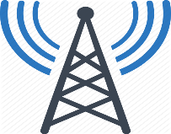

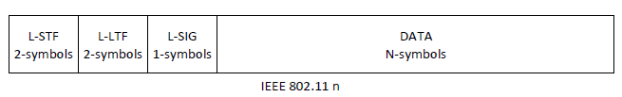
Architecture of Proposed Model
LTE eNB ⬄ Wi-Fi AP
(Same operator)
  Wired connection (ethernet)
Wi-Fi AP ⬄ Wi-Fi AP
(Different operator)
  Wireless connection (reserved bits)
Wired Medium
(delay: 10ms)
LTE eNB
Wi-Fi AP
Operator A
Wireless Medium
9 reserved bits
9 reserved bits
(512 levels)
Wi-Fi AP
Operator B
Simulator used: NS3
LTE LAA model: LTE Release 13
LTE-U model: LTE-U Direct communication
Wi-Fi version: IEEE 802.11n
Used channel: Channel 36 (20MHz)
5170MHz-5190MHz
Propagation model: NS3 indoor loss model
Simulations time: 15s to 50s
User packet type: UDP (1024 bytes)
Continuous UDP transmission.
Notes:
LAA Model: TXOP model paper provided.

Slide 9
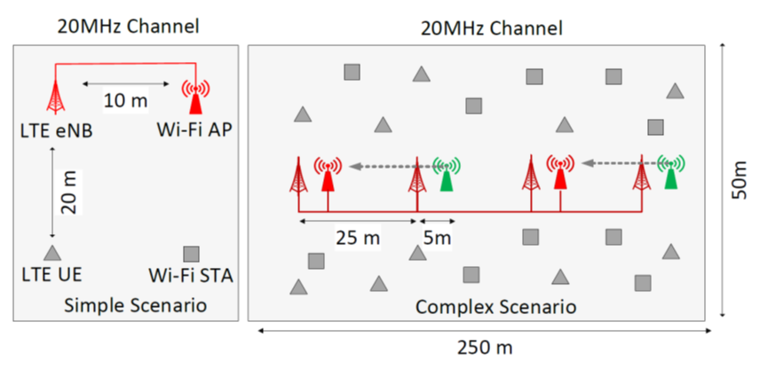
Simulation Scenarios
Operator A: LTE & Wi-Fi coverage.
Operator B: Wi-Fi coverage.
Random walk mobility model used for users in complex scenario.
Simple:
1 LTE eNB, 1 Wi-Fi AP, 1 LTE user, and 1 Wi-Fi user.
Complex:
4 LTE eNB, 4 Wi-Fi AP, 10 LTE user, and 10 Wi-Fi user.
Notes:
Mobility Parameters:
Speed: A random variable used to pick the speed (m/s). [Min=2.0|Max=4.0]
Bounds: Bounds of the area to cruise (m). 0|100|0|100
Direction: A random variable used to pick the direction (radians) [Min=0.0|Max=6.283184]

Slide 10
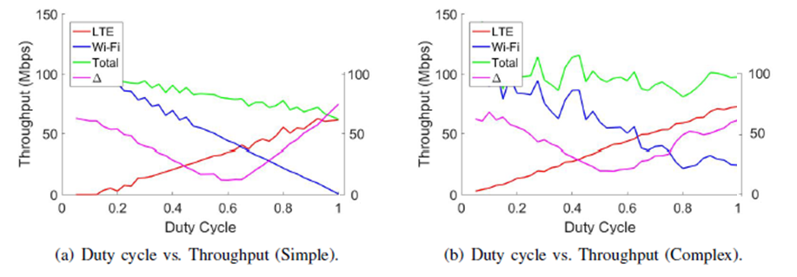


Simulation Results
%
%
40% $Δ$
40% $Δ$
0.5 duty cycle: time fairness, does not guarantee throughput fairness.
Throughput fairness is achieved, and efficiency is acceptable.

Slide 11
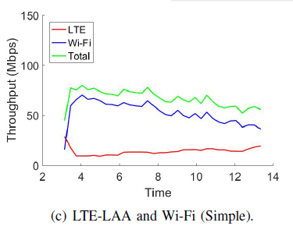
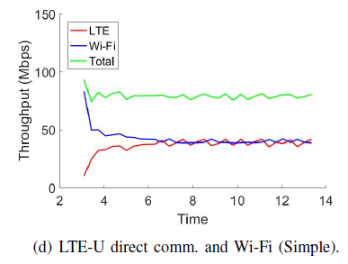
Simulation Results (simple)
(s)
(s)
  High fairness and throughput achieved in LTE-U direct comm.
Notes:
In LTE-LAA, wifi throughput is higher than wifi throughput. In our proposed LTE-U direct communication model, LTE and Wifi throughout become similar.

Slide 12
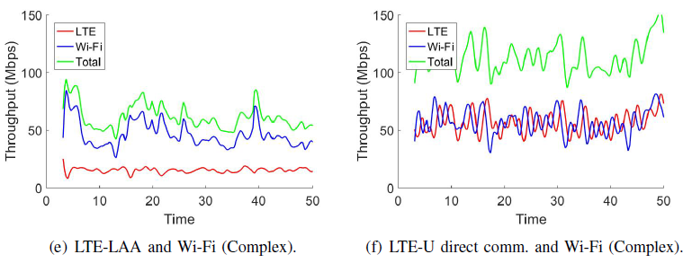
Simulation Results (complex)
(s)
(s)
  High fairness and throughput achieved in LTE-U direct comm.
Notes:
Why throughput changes abruptly in complex scenario?
Multiple user and users are mobile.

Slide 13
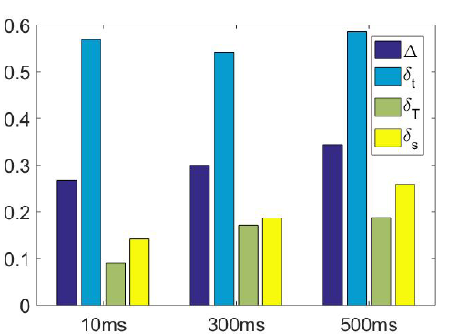


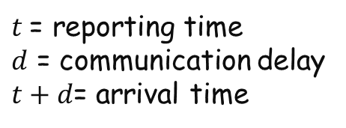



Simulation Results: Effect of Communication Delay
$$t+d$$
$$t$$
LTE eNB
Wi-Fi AP
$t$ = reporting time
$d$ = communication delay
$t+d$= arrival time
$$d$$
Simple scenario
  Higher delay of communication-> Higher deviation from ideal scenario
Notes:
Delays are synthetic.
10ms: delay in communication between LTE-eNB and Wi-Fi AP.
300ms: delay of communicating typical VM in cloud (depends on location of cloud, client and IDP).
500ms: delay of any server in the internet (distant server and slower connection)

Slide 14

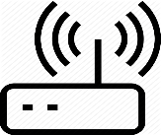
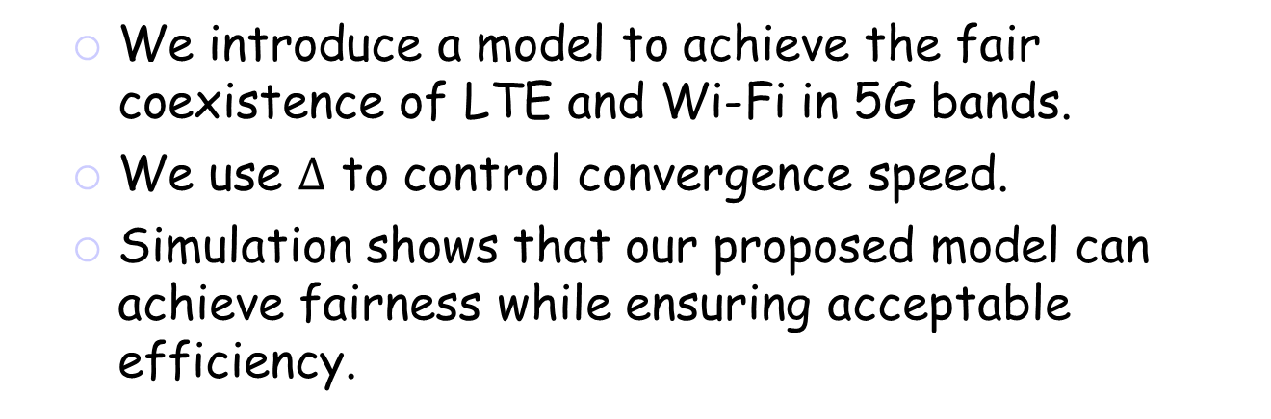
Summary
  We introduce a model to achieve the fair coexistence of LTE and Wi-Fi in 5G bands.
  We use $Δ$ to control convergence speed.
  Simulation shows that our proposed model can achieve fairness while ensuring acceptable efficiency.
Wi-Fi
LTE 5GHz
Usage information
LTE eNB
Wi-Fi AP
LTE
Wi-Fi
LTE
LTE
congested

Slide 15
Q&A

