Slide 1

Optimal Filter Assignment Policy Against
Transit-link Distributed Denial-of-Service Attack
Rajorshi Biswas, Jie Wu
Dept. of Computer and Info. Sciences, Temple University
Wei Chang
Department of Computer Science, Saint Joseph’s University
Pouya Ostovari
Charles W. Davidson College of Engineering, San Jose State University

Slide 2
Transit-Link DDoS Attack
  Attackers generated traffic to the false victim.
  Attack traffic congest some links on the way to victim from users.
  Also known as Link-flooding attack.

Slide 3

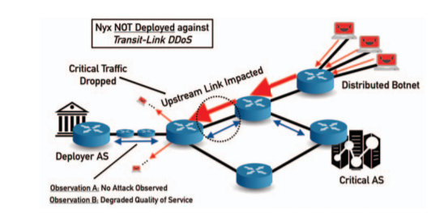
Previous work
Systems | Limitations
SPIFFY (router level attack packet ) | Increased router overhead.
Routing Around Congestion ( BGP-based) | Victim far from the congested link is tough without additional access. Hard to detect whether the congestion is created by attacker or user.
SPIFFY: Inducing Cost Detectability Tradeoffs for Persistent Link-Flooding Attacks (M. Suk Kang et al. NDSS, 2016)
Routing Around Congestion: Defeating DDoS Attacks and Adverse Network Conditions via Reactive BGP Routing (J. M. Smith et al. S&P 2018)

Slide 4
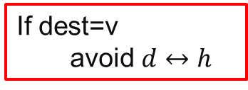
Background: Filter Router and Filter
If dest=v
avoid $d↔h$
Assumption: Victim knows the topology.
  (ISP, packet marking)
Finds possible congested links.
  Based on User traffic rate.
Send filter to Filter router to change route.
Possible congested link
Filter Router:
  Accepts filter and apply that to block links based on destination.
Filter:
  Link blocking rule.
Possible congested link
Non congested link
Non congested link
Regular link
Regular link
Attack traffic Flow
Attack traffic Flow
End user
End user

Slide 5
Protecting User by Sending Filter
Assumption:
  There exist a non congested path from each user.
  Shortest path routing is used.
Send filter to block all possible congested links
  Owner of the FR changes money for applying filter.
Need to block links wisely.
Possible congested link
Non congested link
Regular link
Attack traffic Flow
End user

Slide 6
Problem: Minimizing Blocked Links
Given topology and possible congested links.
Block minimum number of links so that all user traffic follow non congested paths.
Option 1: block 11, 6, 7
  Three blocks (not minimum)
Option 2: Block 3,7
  Two blocks (not minimum)
No traffic travels through possible congested links

Slide 7
Problem: Minimizing Blocked Links
Given topology and possible congested links.
Block minimum number of links so that all user traffic follow non congested paths.
Option 1: block 11, 6, 7
  Three blocks (not minimum)
Option 2: Block 3,7
  Two blocks (not minimum)
No traffic travels through possible congested links

Slide 8
Solution Steps
Step 1: Transformation to line graph
  Edges-> Nodes, red links-> black nodes
Step 2: Create traffic flows
  From all sources, follow all shortest paths.
Step 3: Remove white nodes
  Remove white nodes and concatenate red links
Step 4: Add super user
  Add links to the black nodes who have incident green links
Step 5: Find minimum d-separating set
  Using Acid and Campos’s method

Slide 9
Solution Steps
Step 1: Transformation to line graph
  Edges-> Nodes, red links-> black nodes
Step 2: Create traffic flows
  From all sources, follow all shortest paths.
Step 3: Remove white nodes
  Remove white nodes and concatenate red links
Step 4: Add super user
  Add links to the black nodes who have incident green links
Step 5: Find minimum d-separating set
  Using Acid and Campos’s method

Slide 10
Solution Steps
Step 1: Transformation to line graph
  Edges-> Nodes, red links-> black nodes
Step 2: Create traffic flows
  From all sources, follow all shortest paths.
Step 3: Remove white nodes
  Remove white nodes and concatenate red links
Step 4: Add super user
  Add links to the black nodes who have incident green links
Step 5: Find minimum d-separating set
  Using Acid and Campos’s method

Slide 11
Solution Steps
Step 1: Transformation to line graph
  Edges-> Nodes, red links-> black nodes
Step 2: Create traffic flows
  From all sources, follow all shortest paths.
Step 3: Remove white nodes
  Remove white nodes and concatenate red links
Step 4: Add super user
  Add links to the black nodes who have incident green links
Step 5: Find minimum d-separating set
  Using Acid and Campos’s method

Slide 12
Solution Steps
Step 1: Transformation to line graph
  Edges-> Nodes, red links-> black nodes
Step 2: Create traffic flows
  From all sources, follow all shortest paths.
Step 3: Remove white nodes
  Remove white nodes and concatenate red links
Step 4: Add super user
  Add links to the black nodes who have incident green links
Step 5: Find minimum d-separating set
  Using Acid and Campos’s method
Solution: Block links 3,7

Slide 13
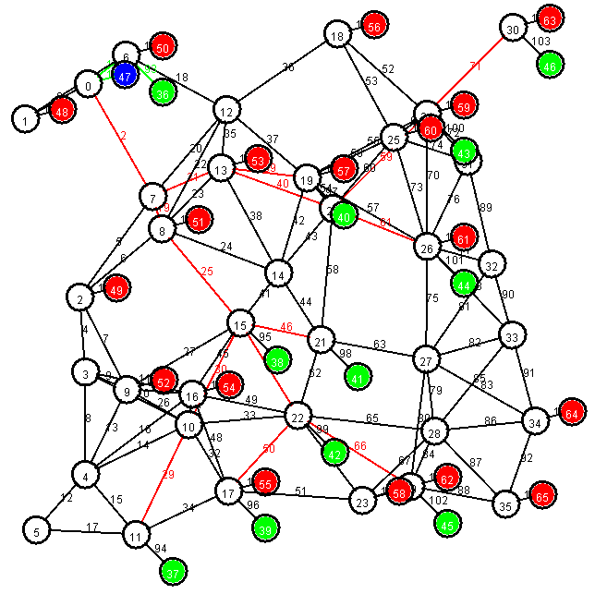
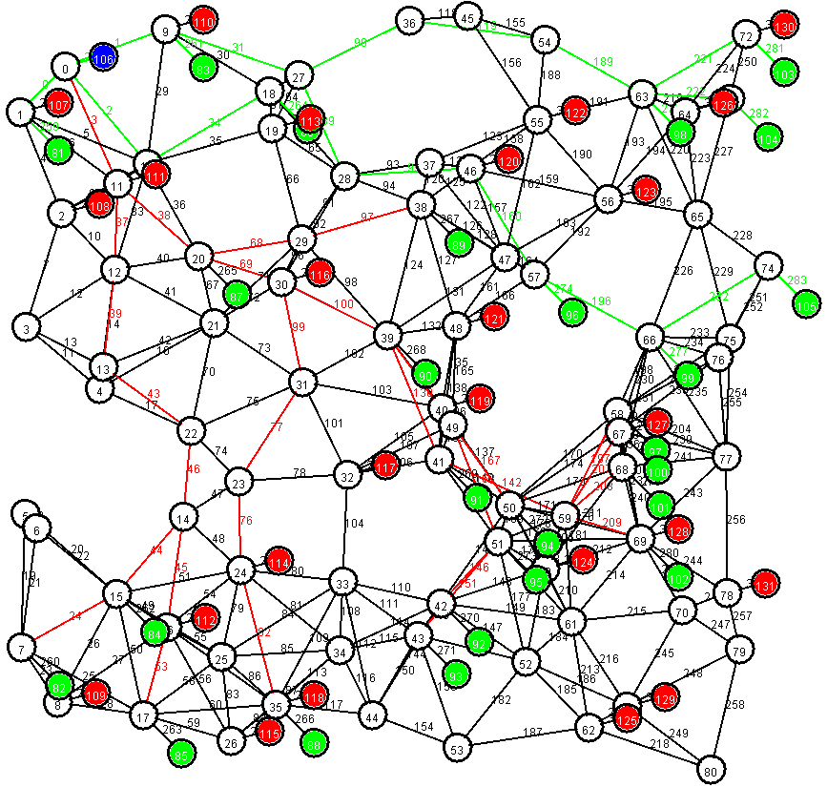
Simulation: Random Topology Generation
Attacker
User
Victim
Topology I
Nodes: 65, Links: 123
Topology I
Nodes: 131, Links: 310
Unite disk graph, Randomly placed nodes (uniform),
Area: 500x500, Neighborhood radius: 70, 50% attackers (chosen randomly)

Slide 14
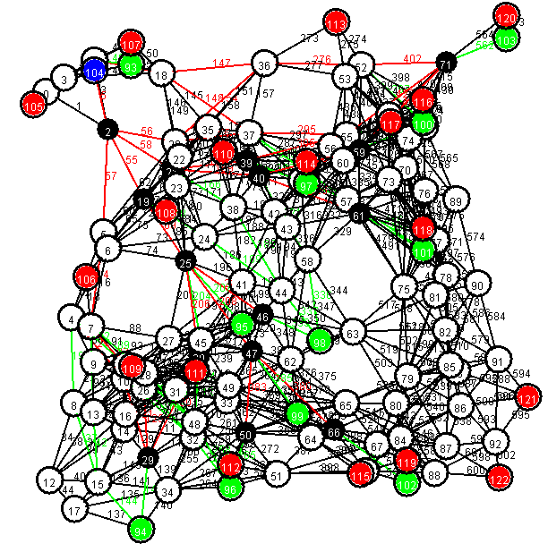
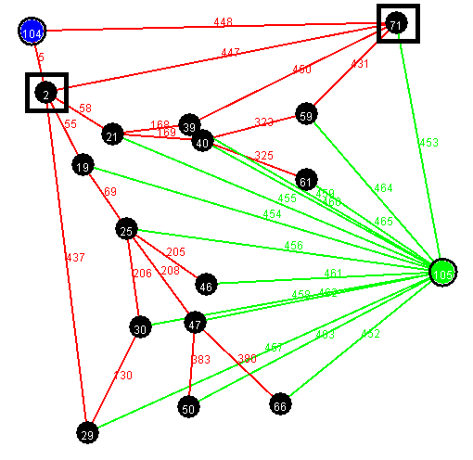
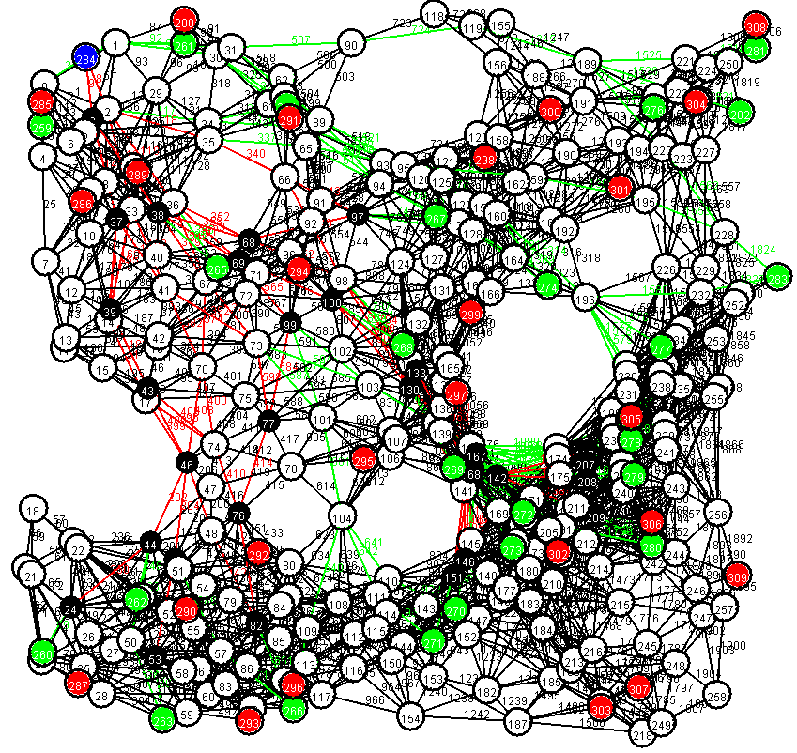
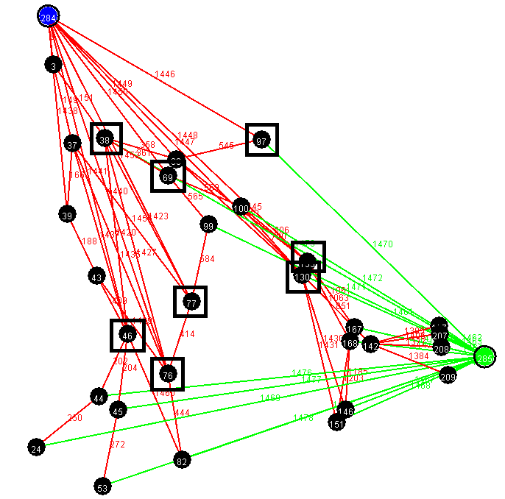
Simulation: Graph Transformations
Topology I
Original Topology
Line graph
Final Graph
Topology II

Slide 15
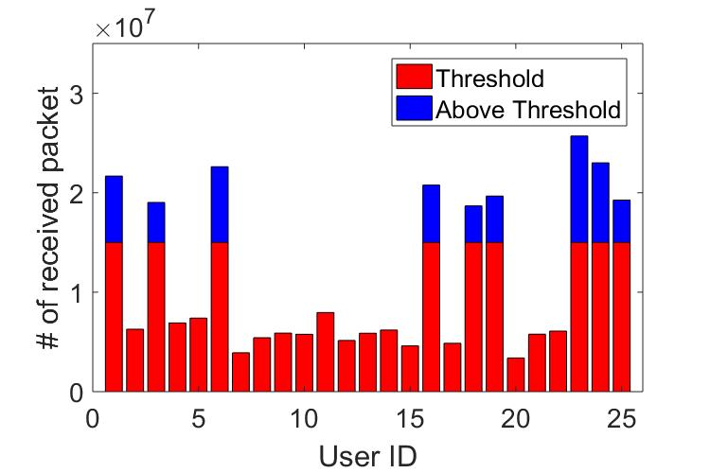
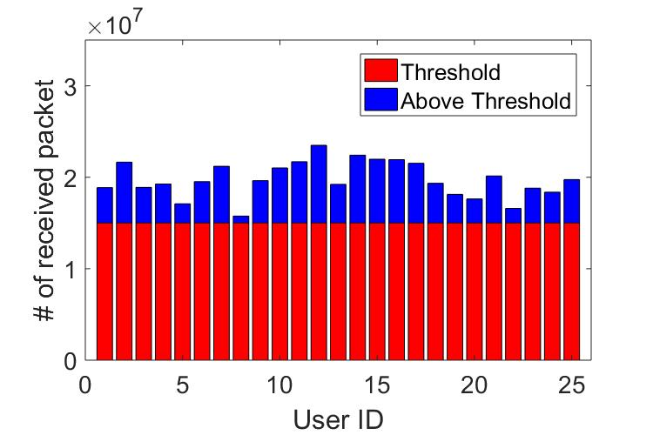
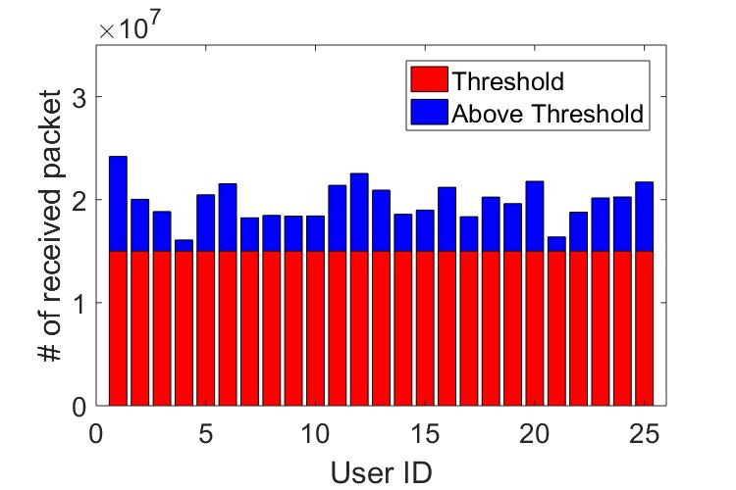
Effect of Filter Deployment
Before attack
After attack
After defense
25 Users, Topology I used
After defense all the users’ data rate is above threshold

Slide 16
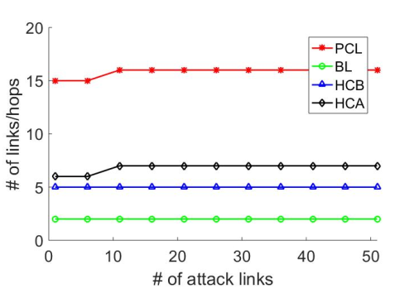
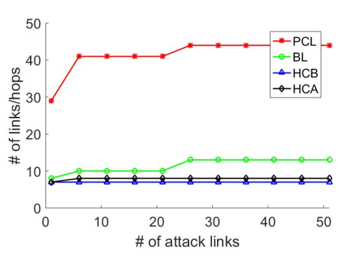
Effect of Number of Attacked Links
Topology I
Topology II
Links to block is much greater than possible congested links are much greater than

Slide 17
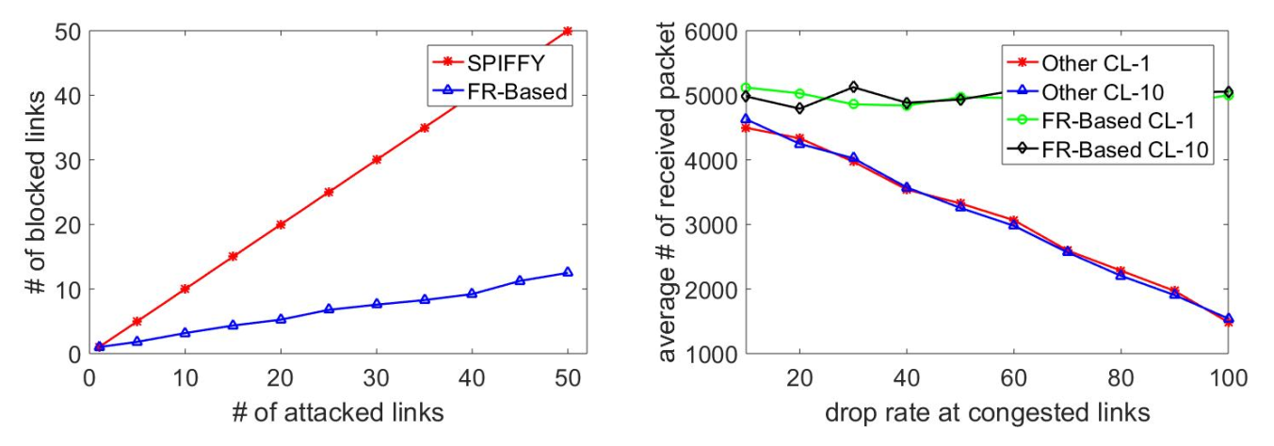
Comparison With Others
Topology I
Topology II
Number of blocked links are always less than SPIFFY
The average number of receied packets is not affected by drop rate at links

Slide 18
Summery
The filter router-based link blockage can defense against transit-link ddos attack better than other approaches.
The links needs to block for redirecting the user traffic through non congested way is much less than the possible congested links.

Slide 19
Q&A

