Slide 1

Cost-Aware Optimal Filter Assignment Policy Against
Distributed Denial-of-Service Attack
Rajorshi Biswas, Jie Wu, and Avinash Srinivasan
Dept. of Computer and Info. Sciences
Temple University

Slide 2

Outline
Introduction to DDoS attack and filter router
Previous works
Four phase DDoS protection system model
Problem: Minimizing blocked legitimate user
Dynamic programming solution
Simulation results
Q & A

Slide 3
DDoS & Four-phase Protection System
DDoS
  Attacker keeps the victim busy.
  Millions of requests are fired by bots.
  Bots are controlled by a master.
Background
  Filter router
    Does packet marking.
    Apply filter and block traffic according to filter.
  Filter
    Simple packet blocking rule.
    Source-based, destination based.
Filter:
If (dest=“v”)
discard
Else
forward

Slide 4
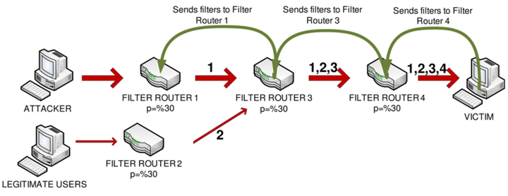
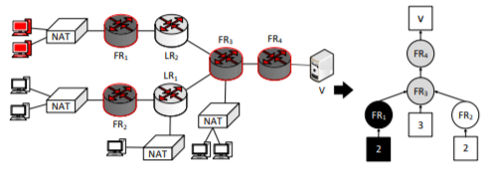
Previous work
Systems | Limitations
Probabilistic Filter Scheduling (packet marking) | Does not consider limited budget on filters. Filter propagation takes some time. Hard to send huge number of filters.
Filter Scheduling (block all attack traffic) | Cannot assign filter optimally. Blocking of all attack traffic increase blocking of legitimate users.
PFS: Probabilistic filter scheduling against distributed denial-of-service attacks (D. Seo et al. in IEEE 36th Conf. Local Comput. Netw, Oct. 2011)
Filter Assignment Policy Against Distributed Denial-of-Service Attack (R. Biswas et al. in IEEE ICPADS, Dec. 2018, )

Slide 5
A Four-phase Protection Process
Phase I: Packet marking by Filter Router.
Phase II: Traffic topology and filter construction.
Phase III: Assign filters to filter router.
Phase IV: Evict unused filter from filter router.
Packet marking (FR)
Topology construction (V)
Filter assignment (V)
Evict filter (FR)

Slide 6


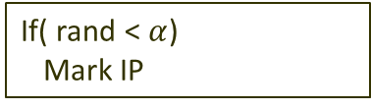
Phase I: Packet Marking by FR
  Filter router (FR) probabilistically appends it own IP address to the packet.
  $α =$marking probability
If( rand < $α$)
Mark IP
S
1
2
3
4
V
2
2 4
Example received packets, $α=0.5$
1 2
1 4
2 4
3
2 3
2 3 4
1
From user S

Slide 7
Phase II: Topology Construction
V
S1
S1 4
V
4
3
S2
S2 5 3
S1
S3
S3 7 3
5
7
S1
S2
S3
S2
S3
Without any marking
After few marking received
V
V
S1 1 4
4
S1 6 4
4
S2 3 4
1
S2 4
3
1
3
S3 2 7
S1
S3 3
6
5
7
5
7
S2
2
S2
2
S1
S3
S3
After few more marking received
After some more marking received

Slide 8
Identifying Attackers’ IP
V
Victim can identify attacker.
  Statistical approaches, packet arrival time, entropy, etc.
Black: only attacker traffic
White: only legitimate traffic
Gray: mixed traffic
4
1
3
6
5
7
S2
2
S1
S3
Sending filters to large # of FR takes long time. The ISP of FR may charge money.

Slide 9
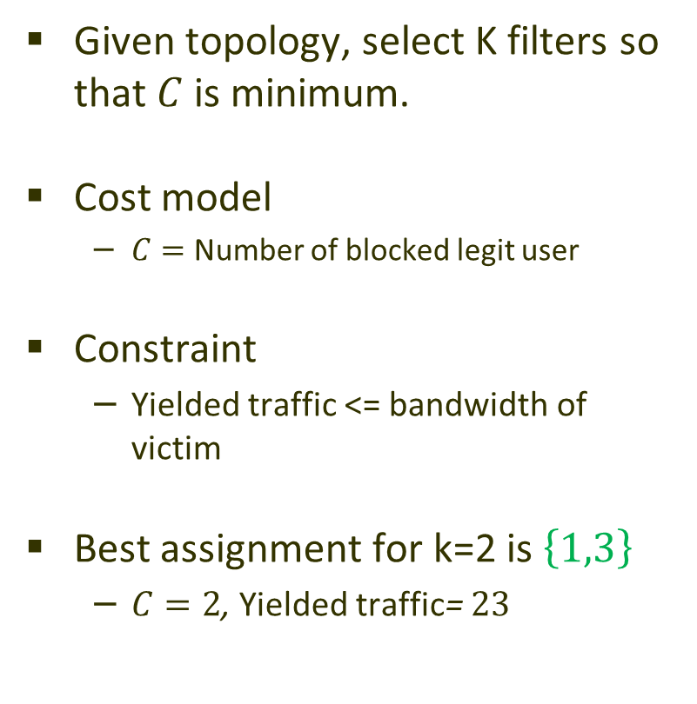
Problem: Minimizing Blocked Legit Users
Given topology, select K filters so that $C$ is minimum.
Cost model
  $C=$ Number of blocked legit user
Constraint
  Yielded traffic <= bandwidth of victim
Best assignment for k=2 is $\left\{1,3\right\}$
  $C=2$, Yielded traffic= $23$
User
v
Attacker
FR
6
4
10
5
1
5
2
3
11
2
8
4
Bandwidth =25

Slide 10
Simplifying the Topology
Remove nodes with no fork.

Slide 11
A dynamic programming solution
Blocks all legitimate users
P(N, K, B)
P(N, K, B)
K B
K
1, 0
N
N
K-1
P(L, k, b)
P(R, K-k, B-b)
OR
k, b
K-k, B-b
L
R
L
R
Nothing to do
k=0,1,…,K b=0,1,…, B
In subtree rooted by N : P(N, K, B)= Minimum blocked LU for K filters by yielding B traffic.
Complexity: O(N(KB)^{(D-1)})

Slide 12


A Dynamic Programming Solution: An Example
P(6, 2, 23)
P(6, 2, 23)
P(6, -, -)
P(4, k, b)
P(3, K-k, B-b)
k, b
K-k, B-b
$$C=∞$$
k=0,1,2 b=0, 1,2,….,13=23-10
$$C=2$$

Slide 13




A DP Solution: An Example
P(4, 0, 0)
P(3, 2, 13)
P(4, 2, 13)
P(3, 0, 0)
$$∞ + ∞=∞$$
$$2 + ∞=∞$$
P(4, 1, 13)
P(3, 1, 0)
P(4, 2, 5)
P(3, 0, 8)
Minimum
$$2 + 0=2$$
$$10 + ∞=∞$$

Slide 14
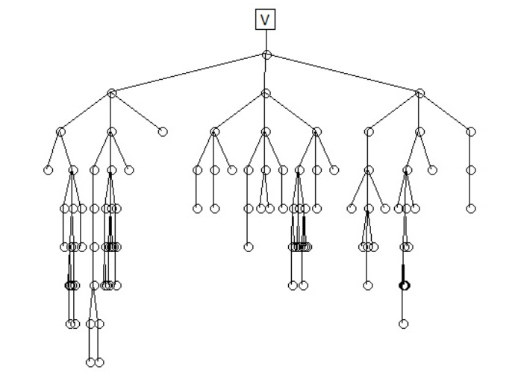
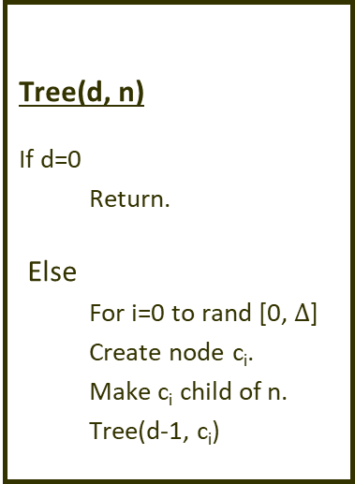
Simulation: Random Tree Generation
Tree(d, n)
If d=0
  Return.
Else
  For i=0 to rand [0, $Δ$]
  Create node c_{i}.
  Make c_{i} child of n.
  Tree(d-1, c_{i})
Topology: 1
Topology: 1
# of nodes : 100
Internal user probability: 0.1
Max node degree= 3
Topology: 2
# of nodes : 400
Internal user probability: 0.1
Max node degree= 20

Slide 15
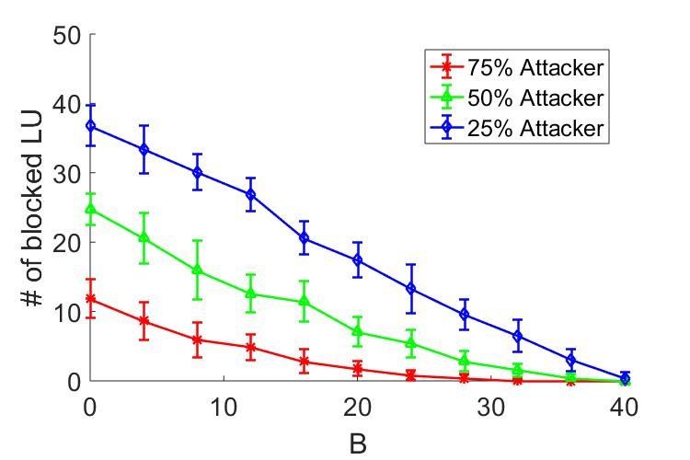
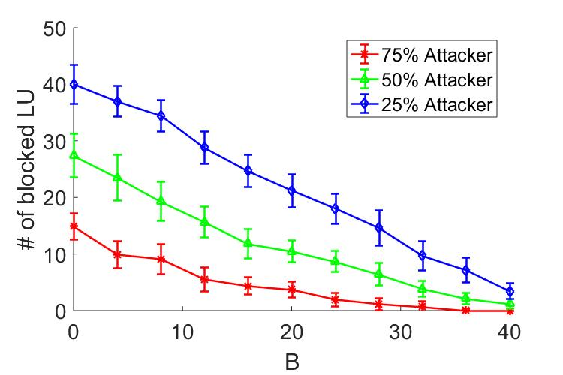
Simulation: Different Incoming Bandwidth
Topology 1
Topology 2
K=10
Number of blocked LUs decreases linearly with the increase of B.

Slide 16
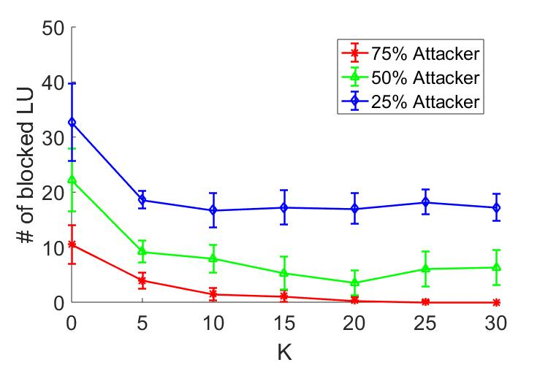
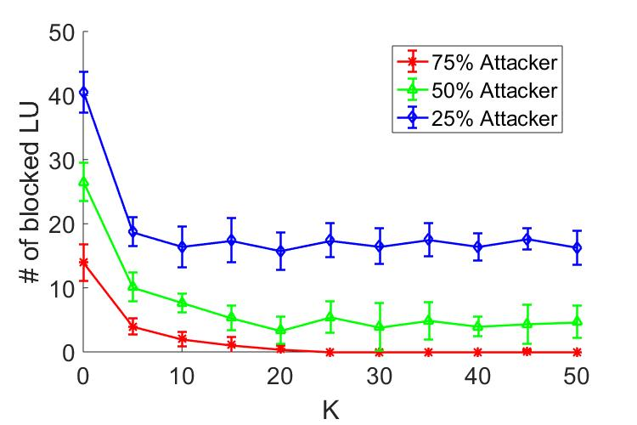
Simulation: Different Number of Filters
Topology 1
B=40
Number of blocked LUs decreases with the increase of K.
Number of blocked LU becomes stable after a certain value of K.

Slide 17
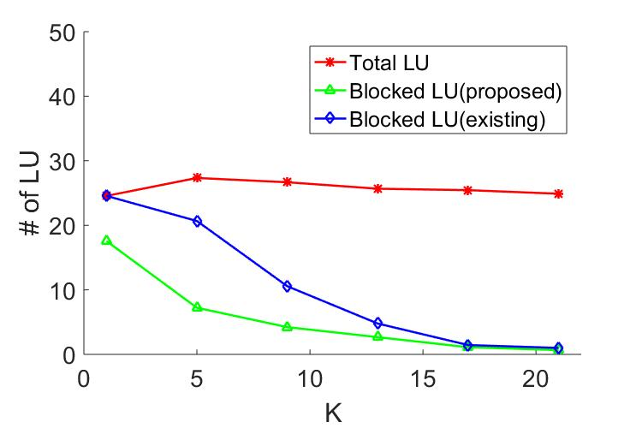
Simulation: Compare with Existing Work
B=40
Number of blocked LUs in proposed system is less than the existing system.

Slide 18

Summary
By allowing some attackers to reach victim we can significantly decrease the number of blocked legitimate user.
User
v
Attacker
P(4, 0, 0)
P(3, 2, 13)
FR
6
4
10
5
1
5
2
3
11
2
8
4
$$∞ + ∞=∞$$

Slide 19
Thank You
Q & A !!!

