Slide 1

Optimal Monitor Placement Policy Against Distributed Denial-of-Service Attack in Datacenter
Rajorshi Biswas, Jie Wu, and Yang Chen
Dept. of Computer and Info. Sciences
Temple University

Slide 2

Outline
Introduction to internal DDoS attack
Previous works
Monitoring system model
Problem 1: Minimizing network overhead
Problem 2: Minimizing network overhead with budget
Simulation results
Q & A

Slide 3
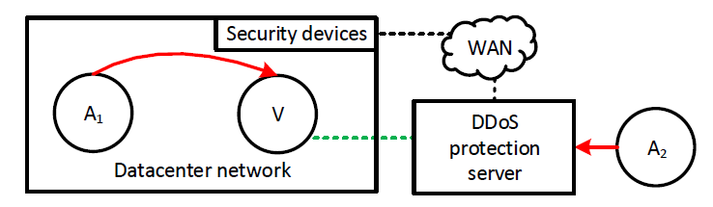
Internal DDoS attack and Commercial DDoS Protection Service
Victim points their domain to DDoS protection server.
DDoS protection server – Victim: Secure tunnel
DDoS protection server
  Forwards legitimate packets only.
Monitoring all the internal flows is necessary

Slide 4


System Model: Monitoring Internal Flows
Every switch is Software Defined Networking (SDN) switch.
Each flow is copied to monitors.
Unused VMs are used as monitors.
  Detect DDoS traffic
  Send report to controller
If DDoS is detected:
  Controller blocks the DDoS from hypervisor of the source
Cost: $0$
Cost: $2×4=8$
  Monitoring cost= bandwidth $×$ # of hops the flow copy travels
Minimize monitoring cost

Slide 5
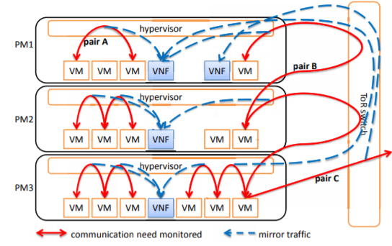
Previous work
Greedy:
Each flow is monitored in closest monitor.
Does not consider limited budget on VMs.
100% copy of flows cannot guarantee monitoring of all flows.
Optimal Placement of Network Security Monitoring Functions in NFV-Enabled Data Centers (P. lin et al. in (SC2), Kanazawa, 2017)

Slide 6
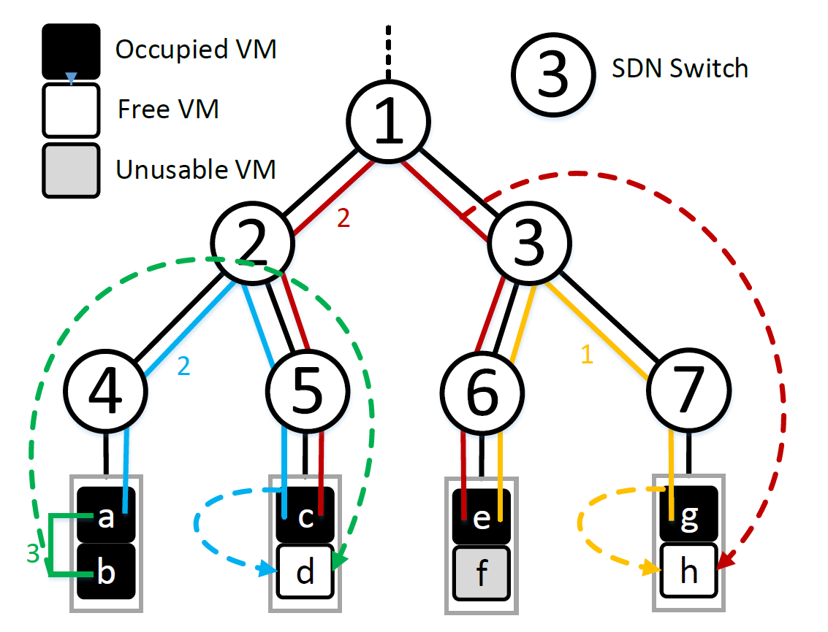
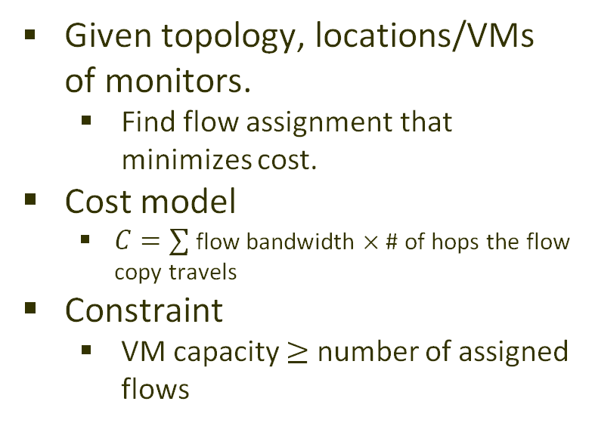
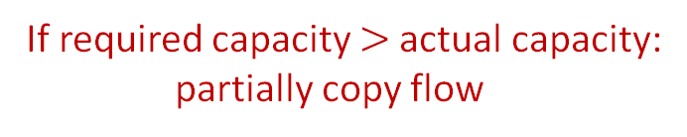
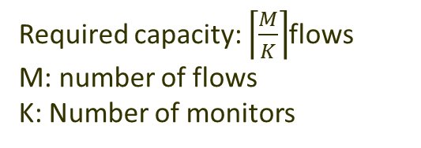
Problem 1: Find Flow Assignment
Given topology, locations/VMs of monitors.
  Find flow assignment that minimizes cost.
Cost model
  $C=∑$ flow bandwidth $×$ # of hops the flow copy travels
Constraint
  VM capacity $≥$ number of assigned flows
Monitor capacity: 2 flows
Required capacity: $\left\lceil \frac{M}{K}\right\rceil$flows
M: number of flows
K: Number of monitors
Unusable VM
If required capacity $>$actual capacity:
partially copy flow
Monitoring cost: 12+0+0+4=16

Slide 7
Solution Steps
Step 1: Create bipartite graph
  Partition unused VMs.
  Calculate cost between flow and VM.
Step 2: Create flow graph
  Add source and destination.
  Set capacity=1 for all edges.
  Set cost = 0 for new edges.
Step 3: Find minimum cost maximum flow.
  Cheapest augmenting path
  # of partitions=capacity

Slide 8
Solution Steps
Step 1: Create bipartite graph
  Partition unused VMs.
  Calculate cost between flow and VM.
Step 2: Create flow graph
  Add source and destination.
  Set capacity=1 for all edges.
  Set cost = 0 for new edges.
Step 3: Find minimum cost maximum flow
  Cheapest augmenting path

Slide 9

Solution Steps
Step 1: Create bipartite graph
  Partition unused VM. according to capacity.
  Calculate cost between flow and VM
Step 2: Create flow graph
  Add source and destination.
  Set capacity=1 for all edges.
  Set cost = 0 for new edges.
Step 3: Find minimum cost maximum flow
  Cheapest augmenting path
Complexity: $O\left(M^{3}+S^{3}\right)$
M: # of flows, S: # of SDN switches

Slide 10
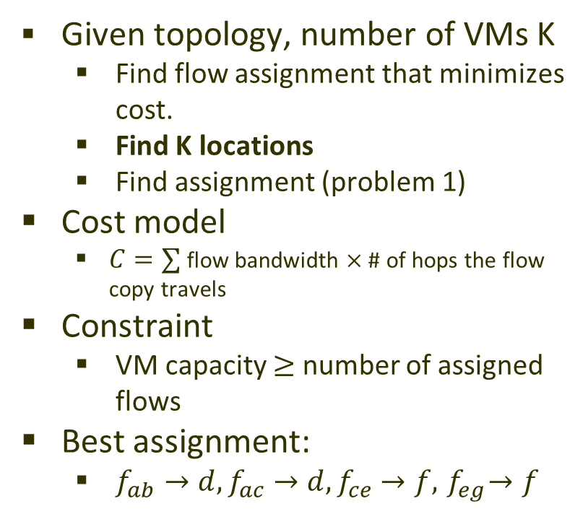
Problem 2: Find Flow Assignment (Limited Budget)
Given topology, number of VMs K
  Find flow assignment that minimizes cost.
  Find K locations
  Find assignment (problem 1)
Cost model
  $C=∑$ flow bandwidth $×$ # of hops the flow copy travels
Constraint
  VM capacity $≥$ number of assigned flows
Best assignment:
  $f_{ab}→d, f_{ac}→d, f_{ce}→f, { f}_{eg}→f$
Monitoring cost: 12+0+0+0=12

Slide 11
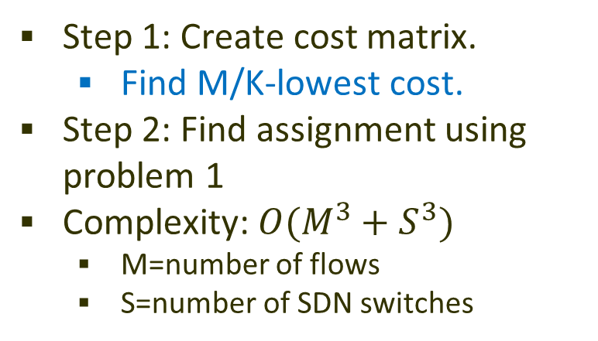
Solution Steps: M/K-lowest cost (MKLC)
Step 1: Create cost matrix.
  Find M/K-lowest cost.
Step 2: Find assignment using problem 1
Complexity: $O(M^{3}+S^{3})$
  M=number of flows
  S=number of SDN switches
M=4, K=2
Monitor capacity required: 2

Slide 12
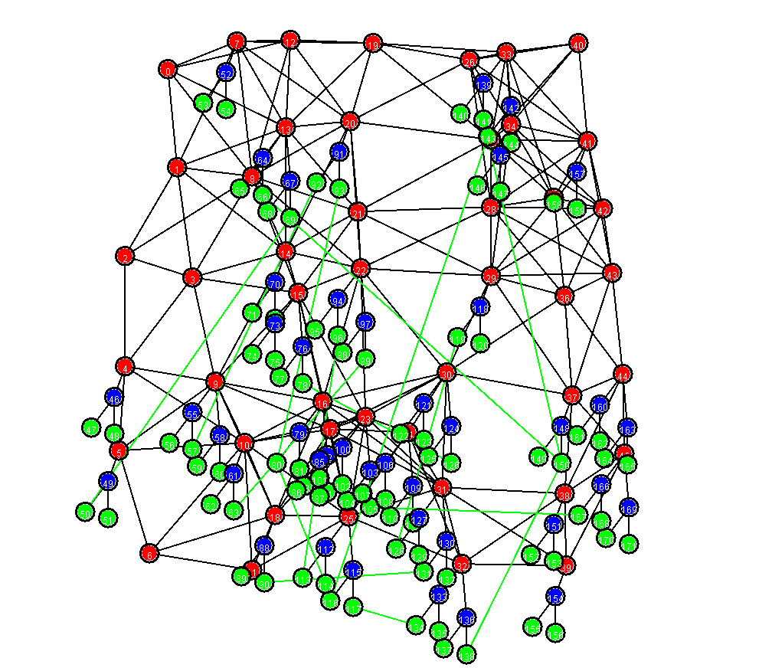
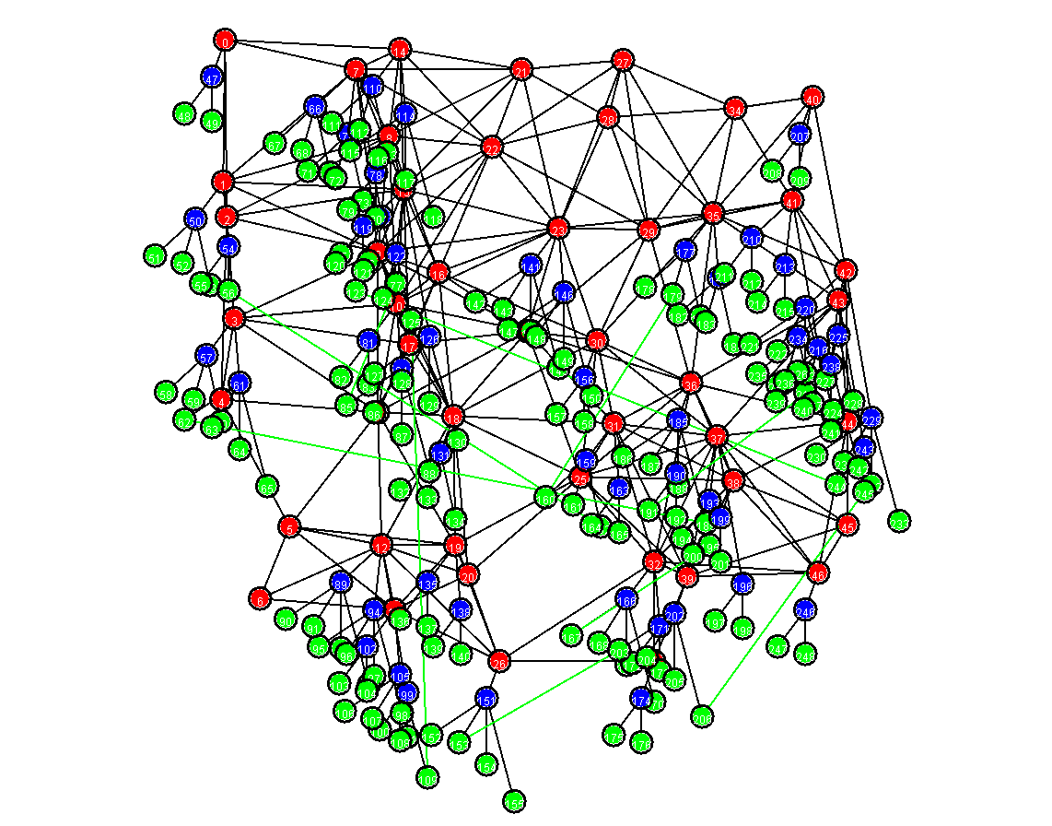
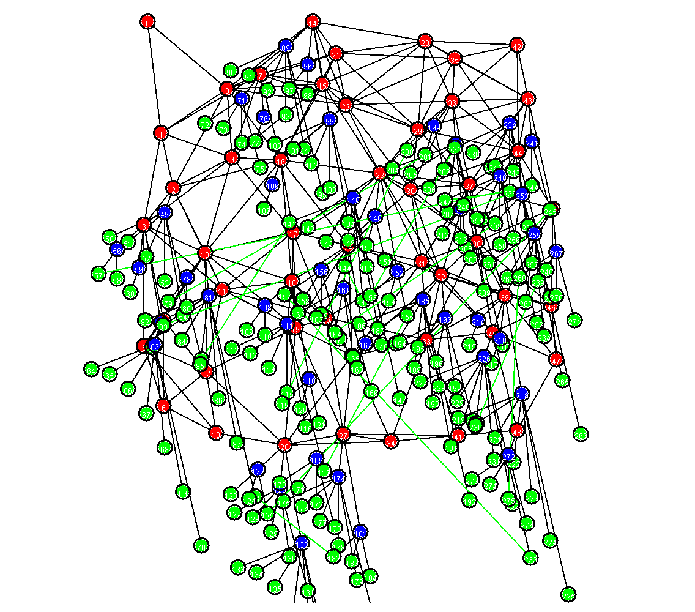
Simulation: Randomly Generated Topologies
Topology I
Nodes: 172
VMs/PMs: 84/43
SDN SWs: 46
Links: 304
Topology II
Nodes: 249
VMs/PMs: 150/52
SDN SWs: 47
Links: 392
Topology III
Nodes: 277
VMs/PMs: 184/44
SDN SWs: 49
Links: 427
Unite disk graph, Randomly placed nodes (uniform), Randomly generated flows
Area: 500x500, Neighborhood radius: 70

Slide 13
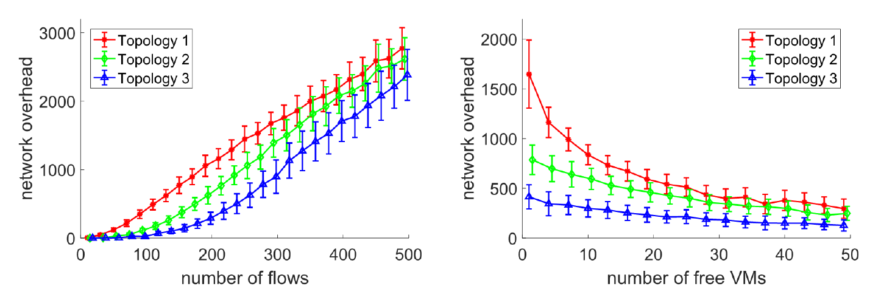
Simulation: Different Number of Flows and Unused VMs
Network overhead linearly increases with the number of flows.
Number of free VMs=20
Network overhead decreases with the number of unused VMs.
Number of flows= 500

Slide 14
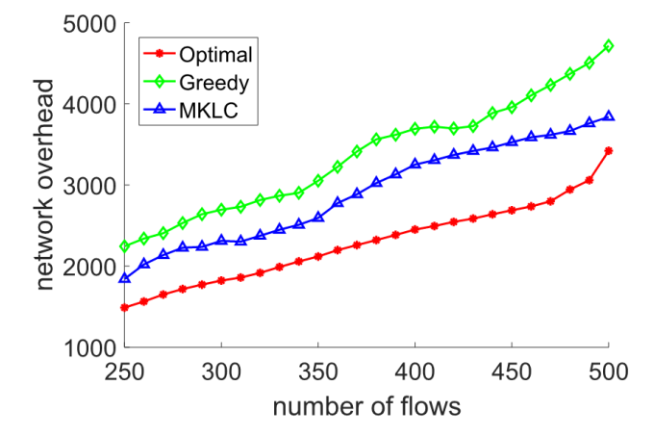
Simulation: Comparison with Existing Solutions
K=9
# of SDN SWs=100
Random topology
MKLC network overhead 27% is higher than optimal.
Greedy network overhead 48% is higher than optimal.

Slide 15
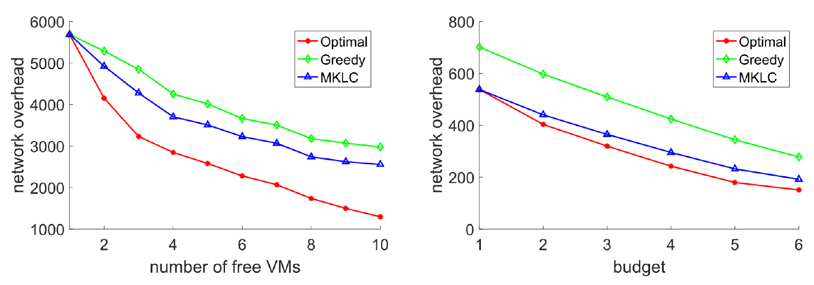
Simulation: Comparison with Existing Solutions
K: # of free VMs/2
# of Flows: 100
MKLC network overhead is lower than Greedy network overhead.

Slide 16
Summary
Our proposed M/K lowest cost approach can produce lower network overhead than the existing greedy approach.

Slide 17
Thank You
Q & A !!!

